Slide 1
FBC MISSION TEAM
BRAZIL TRIP REPORT SUNDAY
JUNE 29, 2025

Slide 2
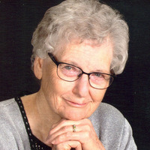


IMPORTANT DATES TO REMEMBER:
UICBB (Uniao das Igrejas Congregacionais Biblicas do Brasil) – Nov. 1, 1964
STBT - Seminário Teológico Bíblico Thompson – March 1, 1968 in Umuarama
*Classes began in Vitoria da Conquista, Bahia: January 2021
COAT - Colégio Alice Thompson – Classes began February 2018
COAT Inauguration: June 16, 2017 (Alice Thompson was present)
Avenida Pedro Francisco de Moraes Filho, 307 Loteamento Morada dos Pássaros - Felicia, Vitória da Conquista - BA, 45055-505, Brazil
BIM Incorporated non-profit organization in May 1955 in the State of Illinois
BIM Incorporated in the Republic of Brazil in September 1958
Merge date of BIM & BGFM-GLOBAL: October 20, 2018 (Dissolution of BIM & transfer of funds)

Slide 3
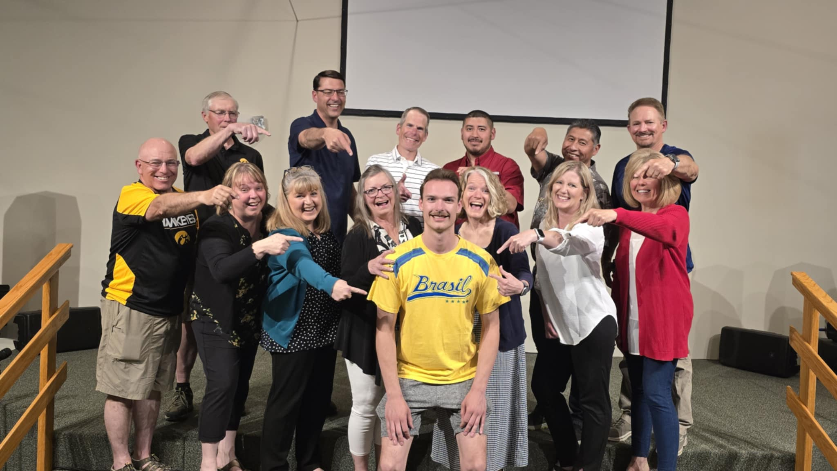

Slide 4
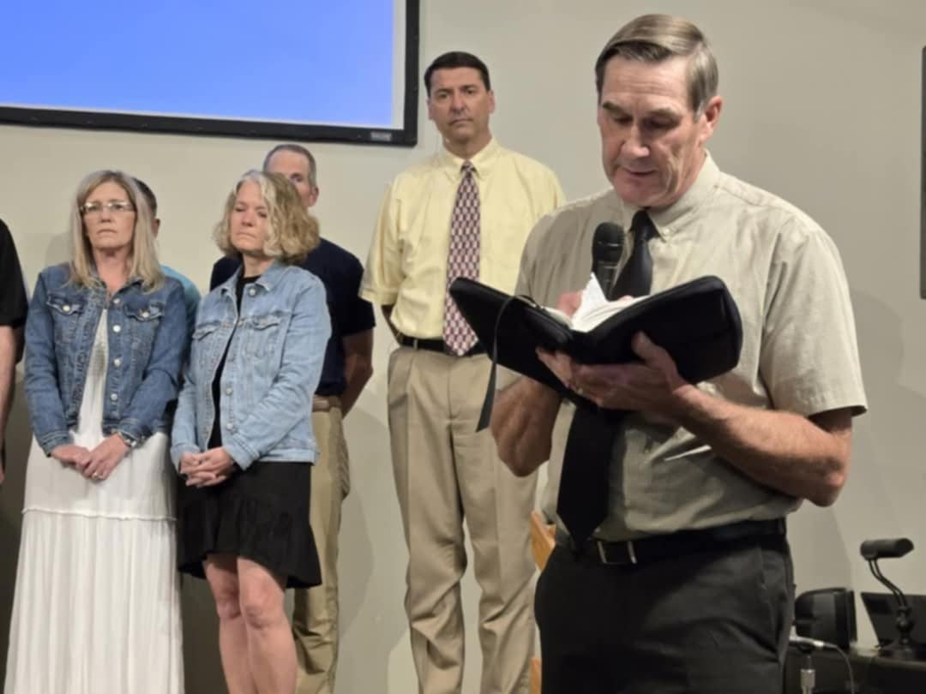
COMMIS-
SIONING SUNDAY:
JUNE 1, 2025

Slide 5
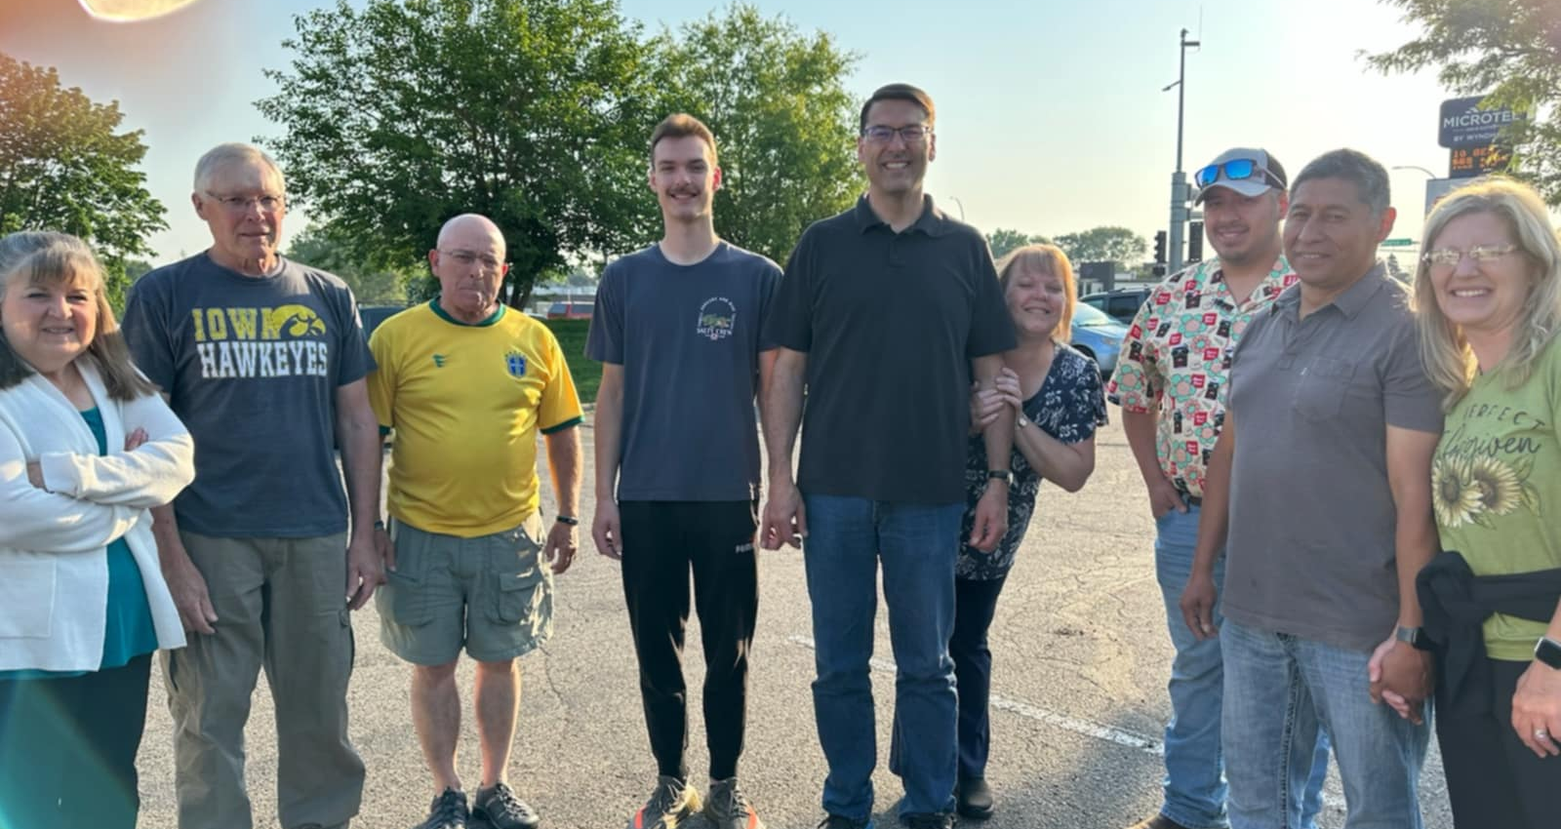
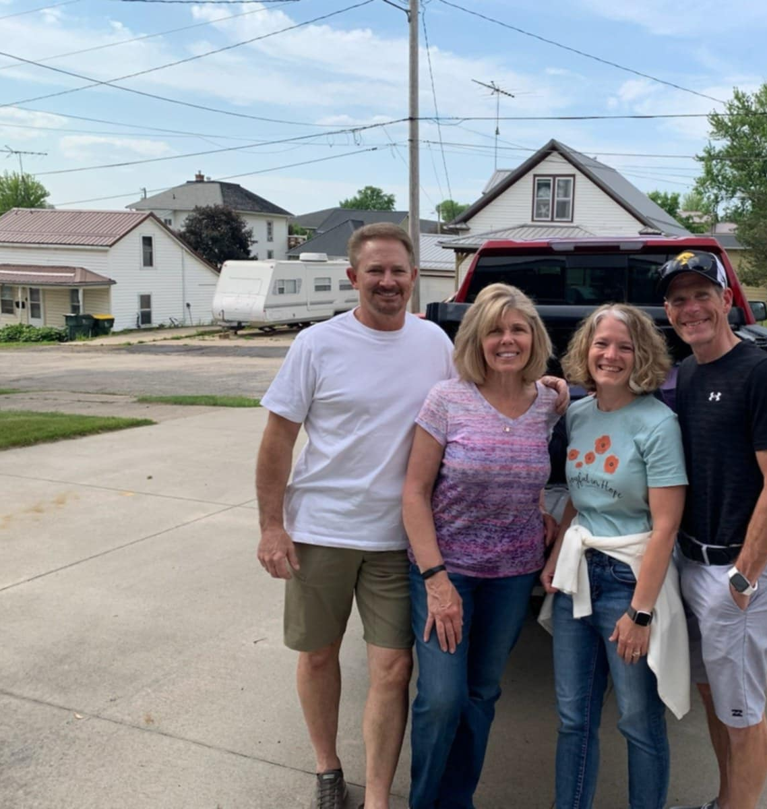
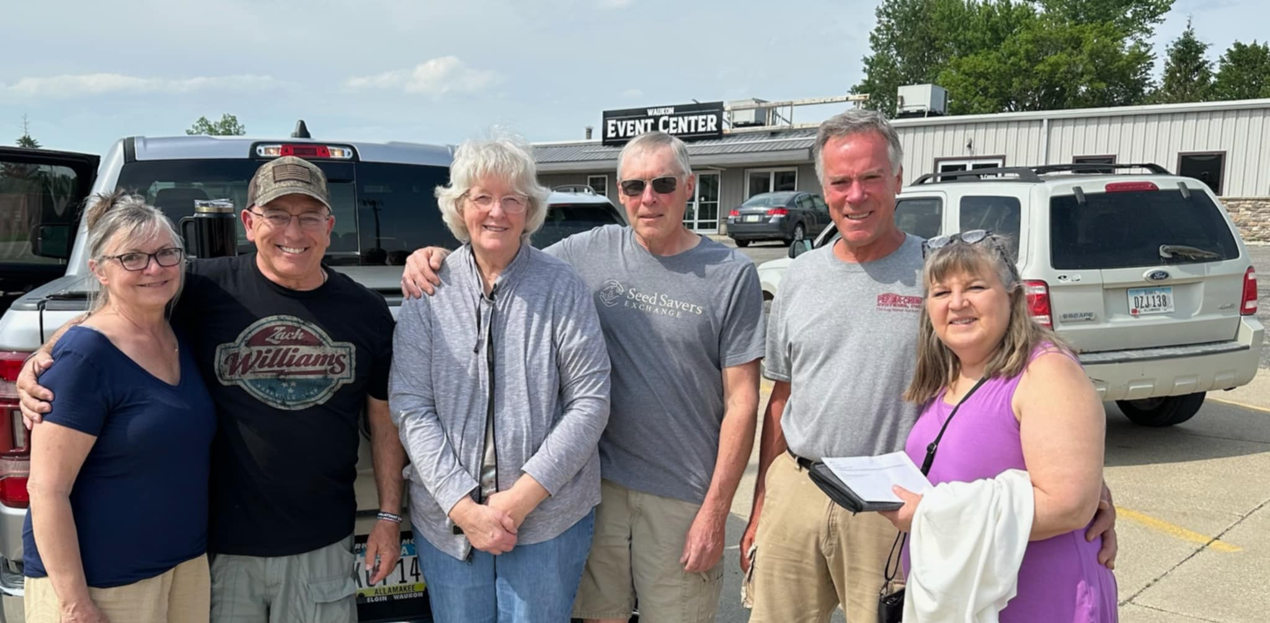
We departed in 4 different cars to spend the night in Minneapolis on June 4th

Slide 6
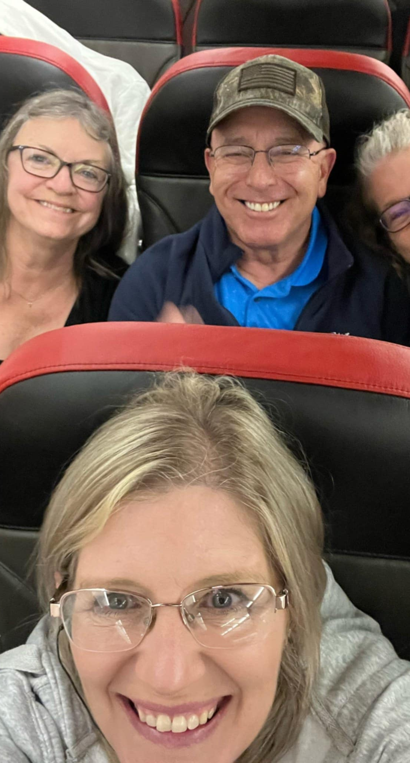
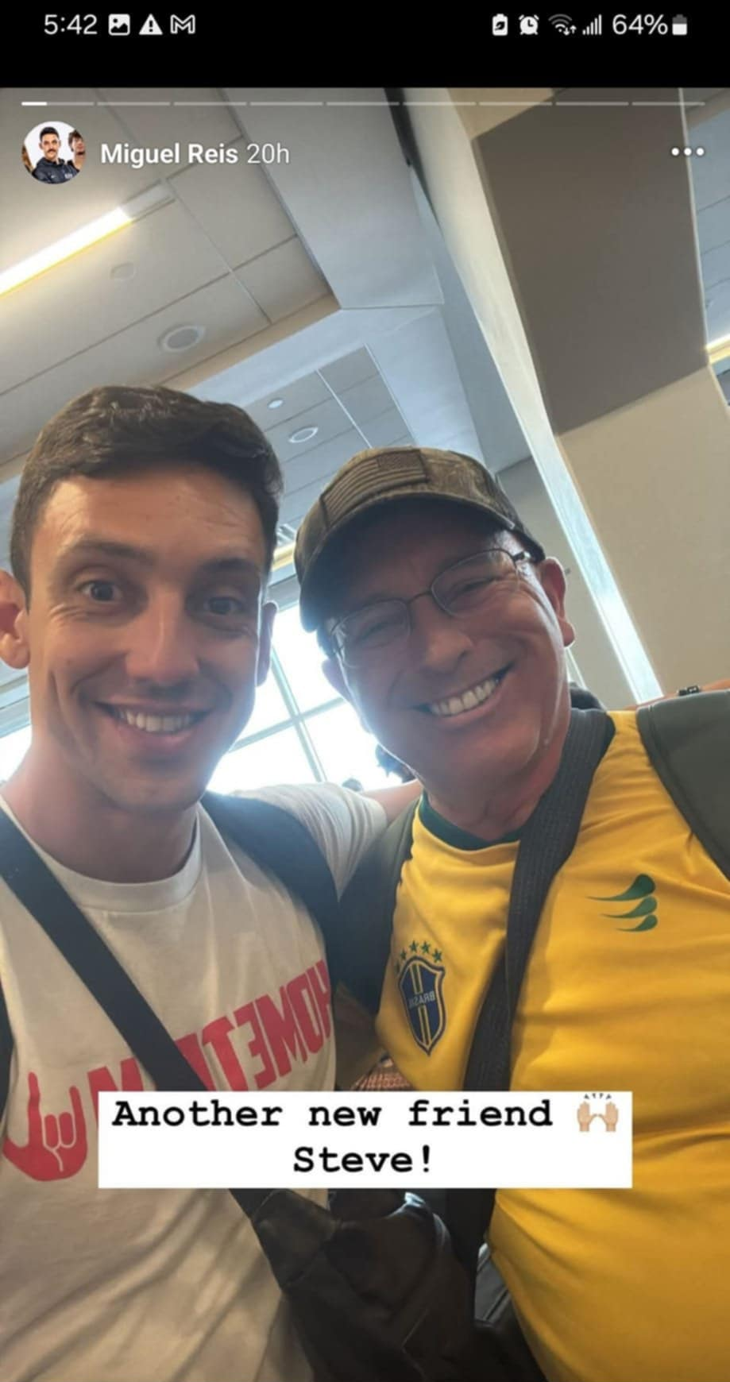
So many airplane rides….let’s just say airplanes got a little “old!” ☺
And, we met a new friend, Miquel (right), at the Dallas airport! He is a professional athlete, born-again believer, who is living in the USA and a youth pastor!

Slide 7
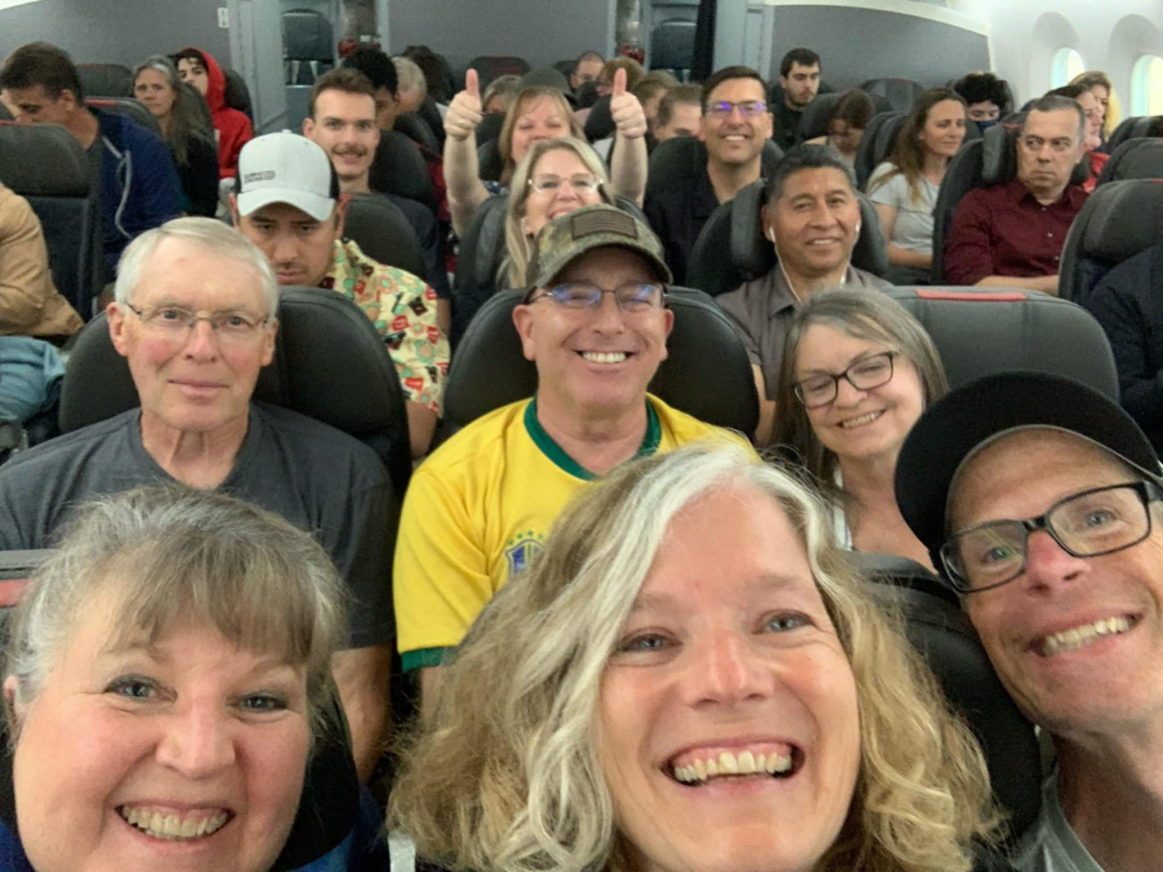

Slide 8
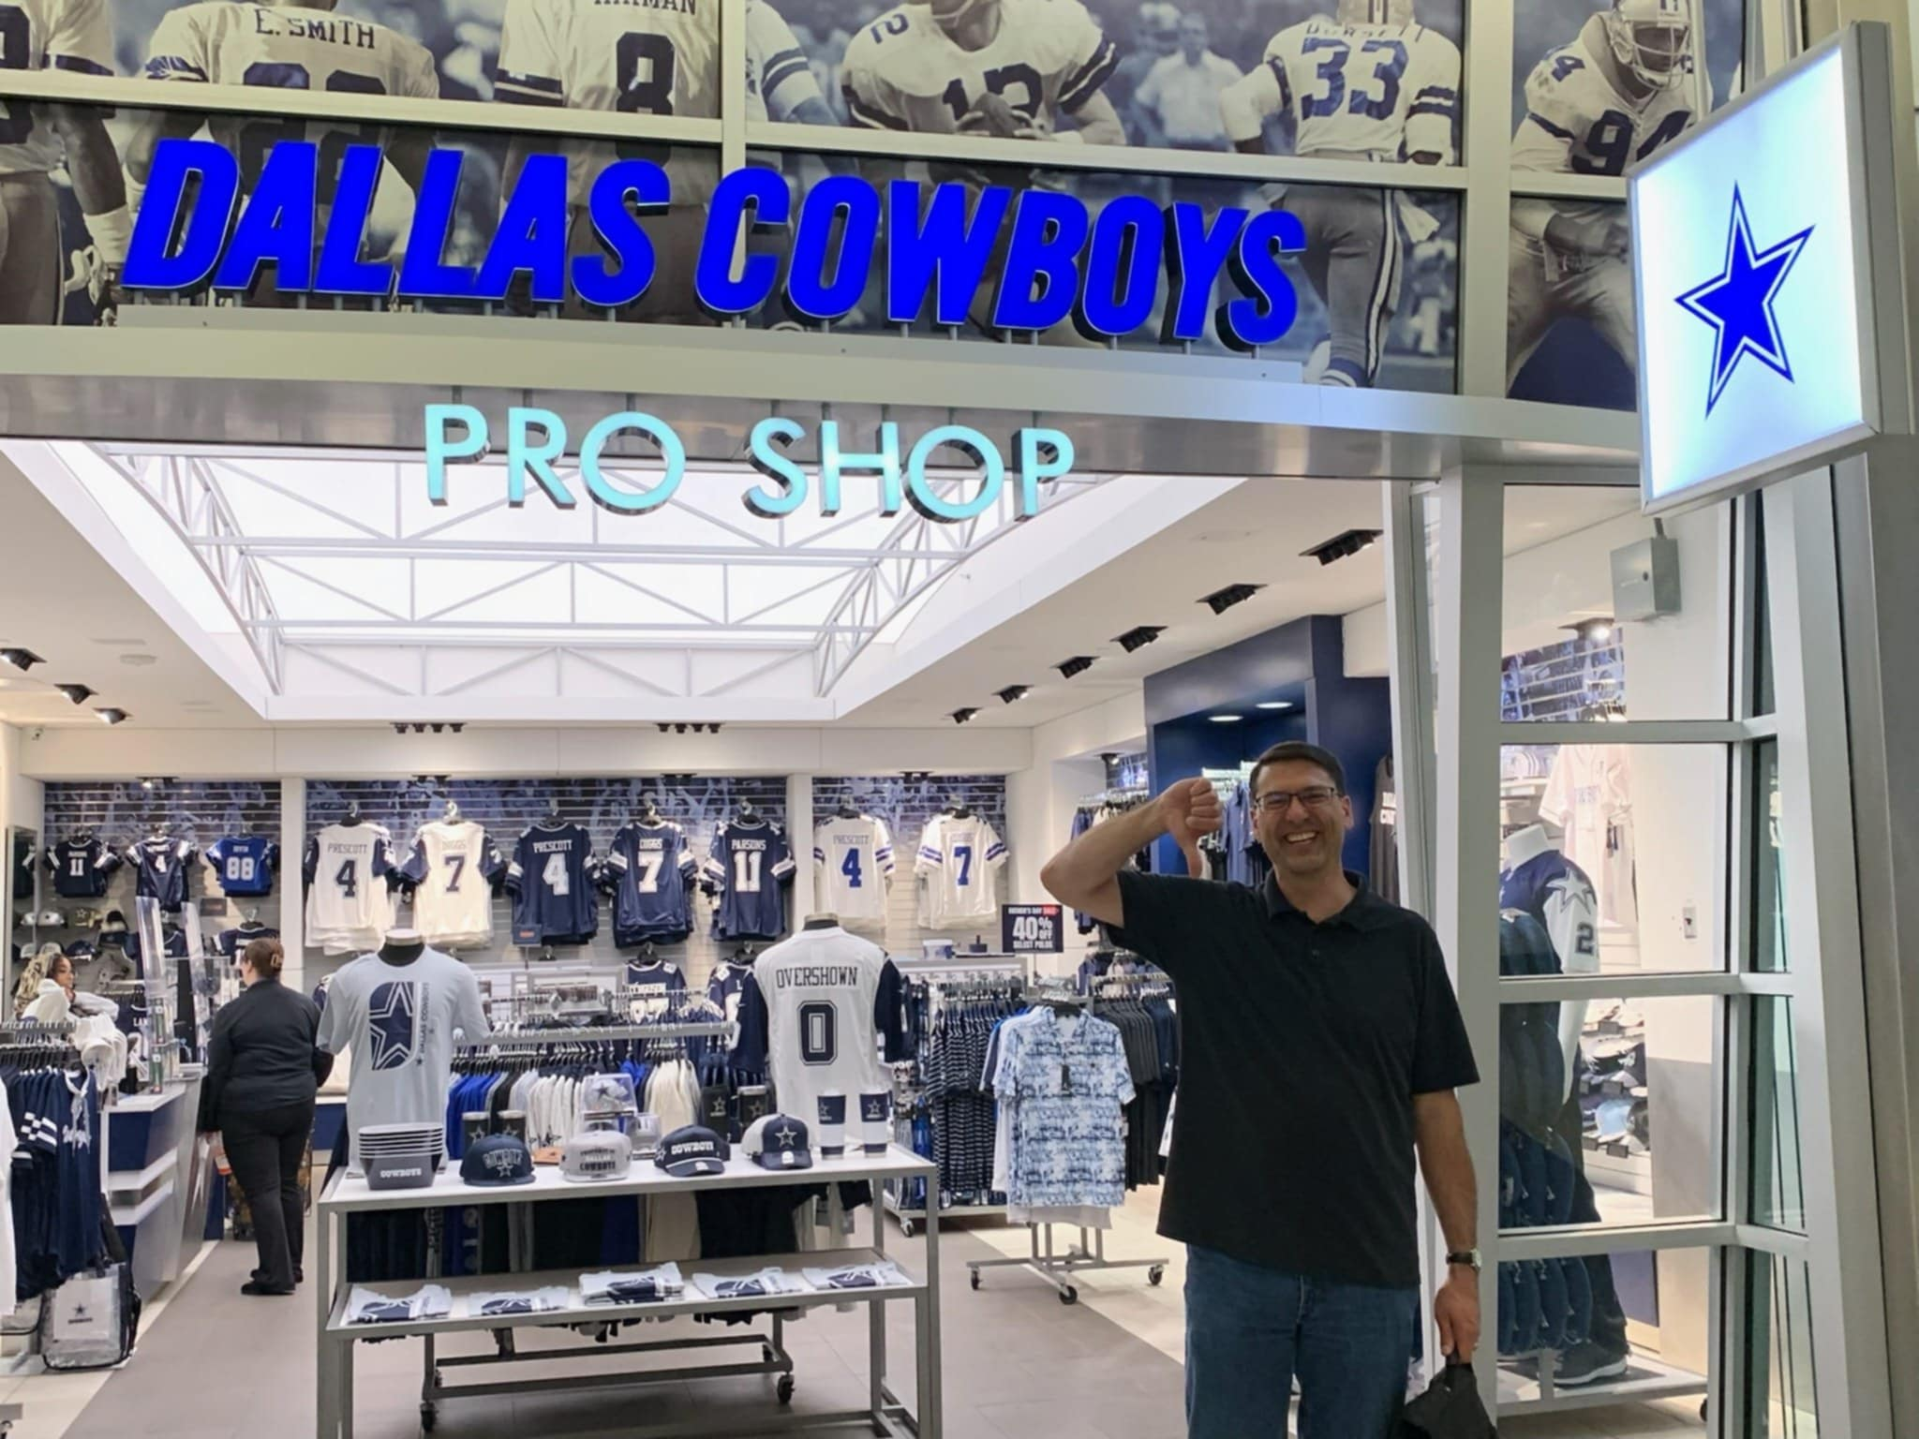

Slide 9
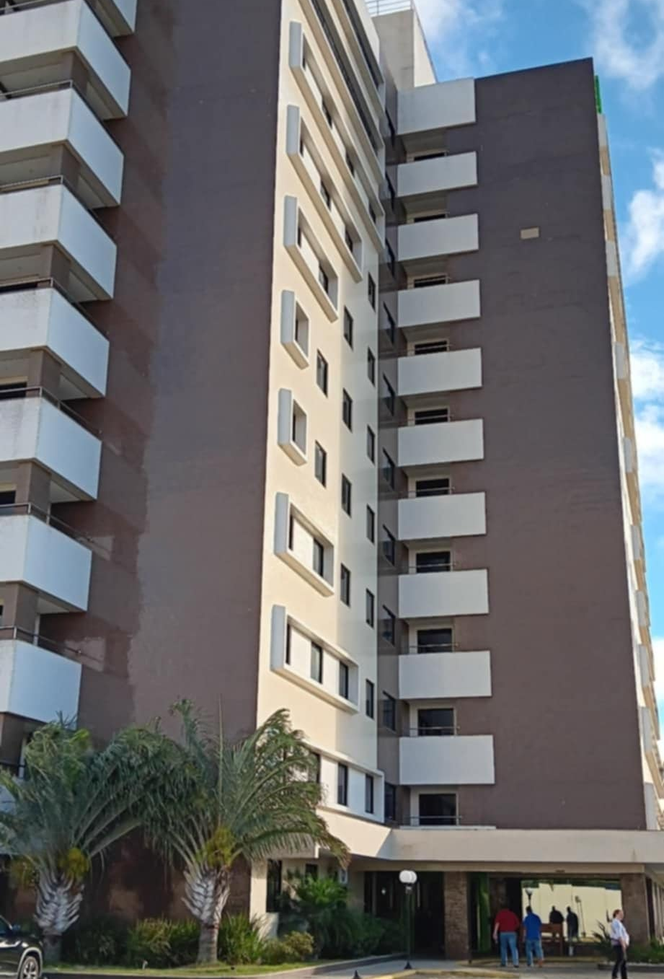
“IBIS” HOTEL
(Our stay in Conquista)

Slide 10
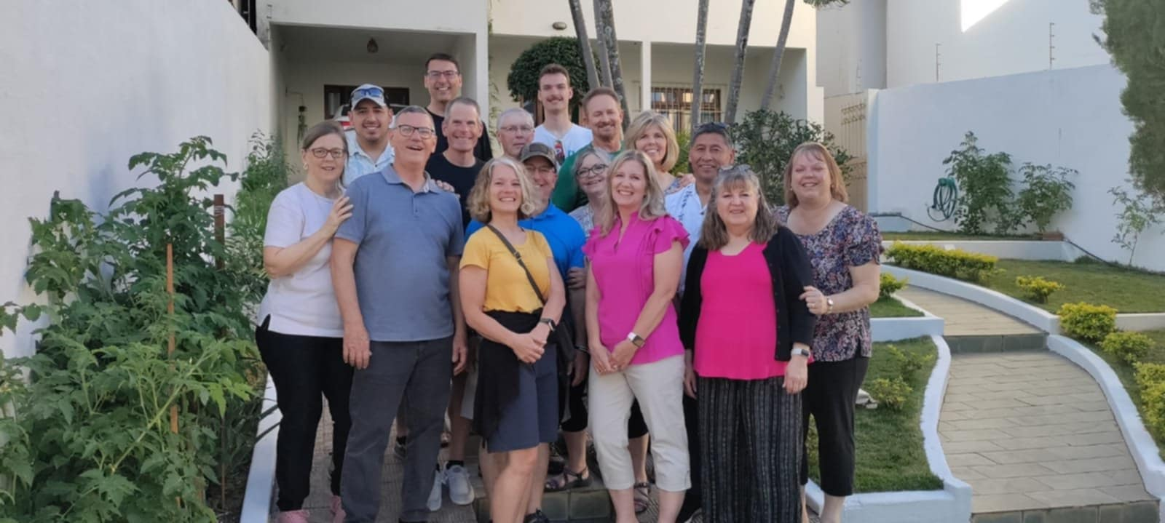
In front of David & Debbie’s house
(David & Debbie were wonderful hosts!)

Slide 11
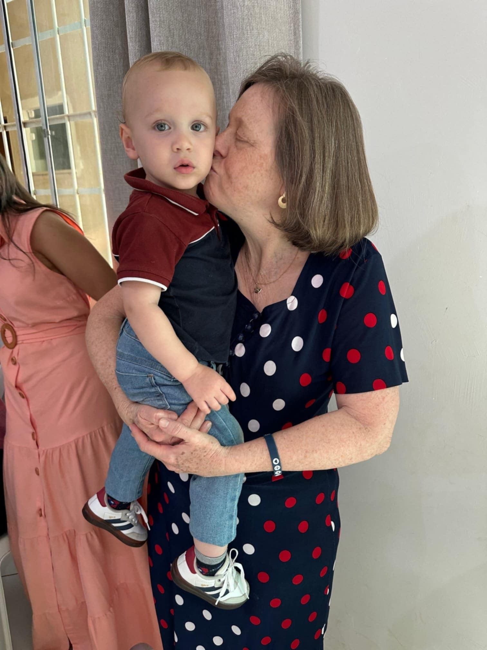
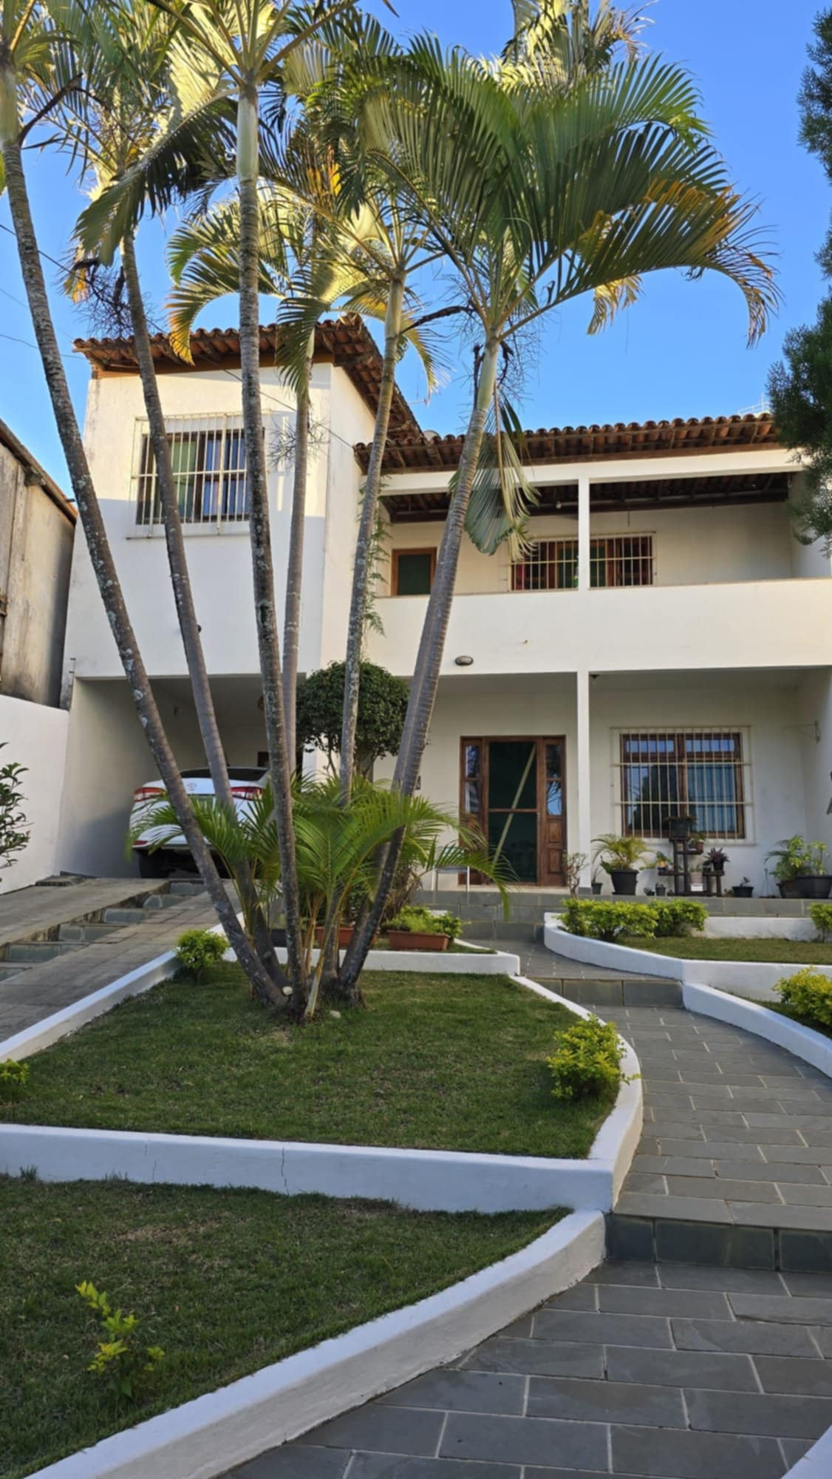
OLIVER!
Victor & JoAnna’s son

Slide 12
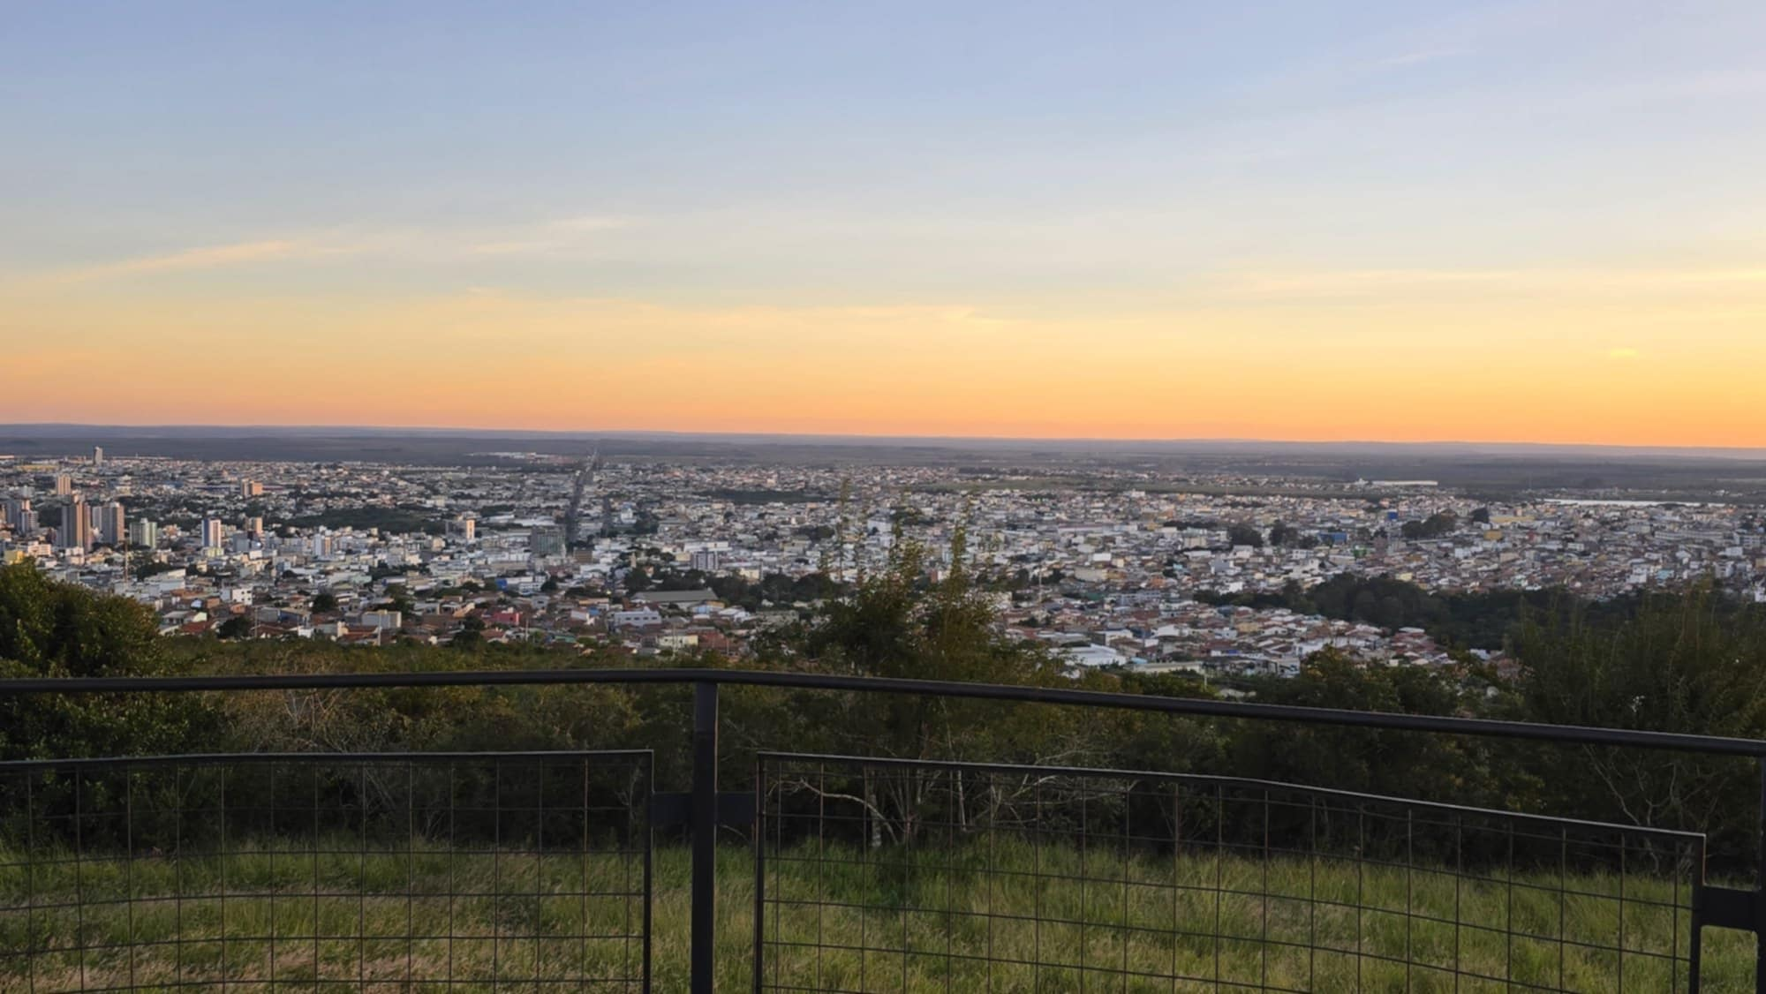
View: From the highest point of Conquista, looking down upon the city!

Slide 13
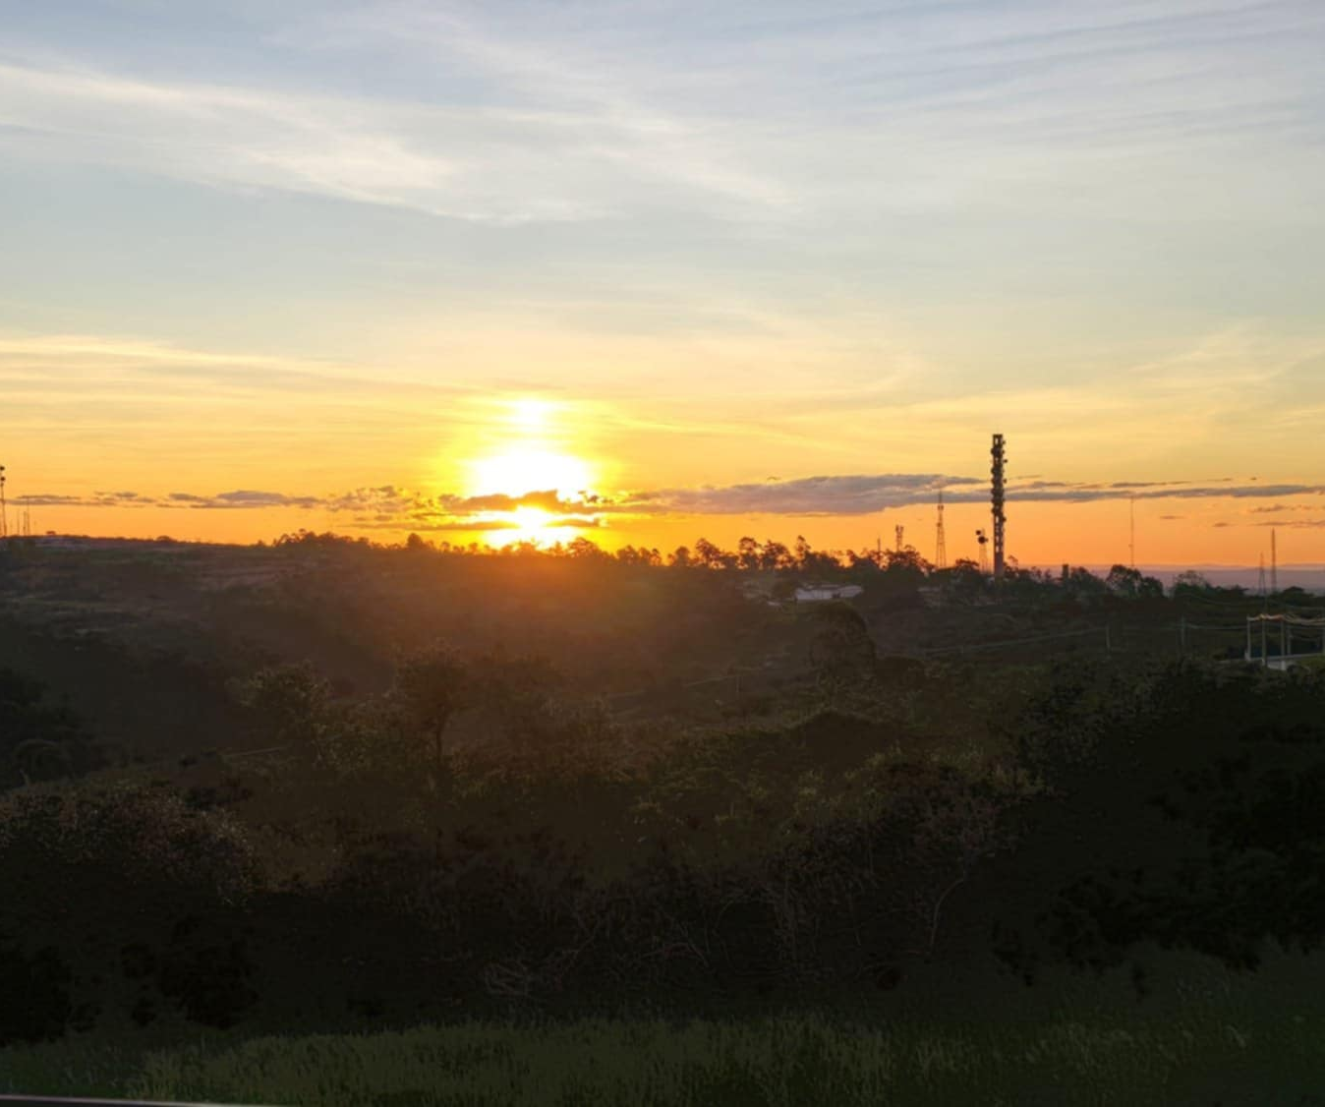
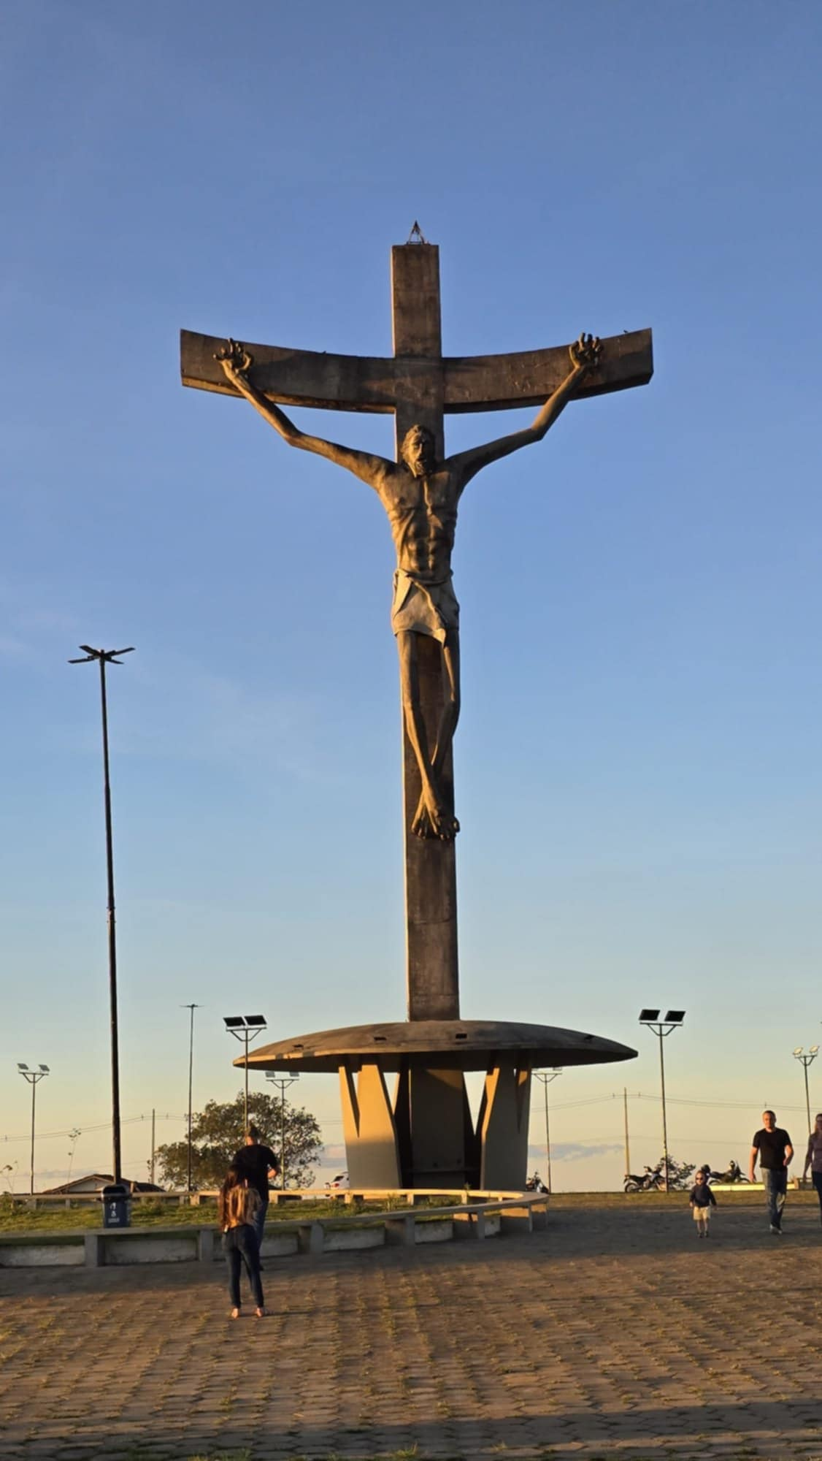

Slide 14
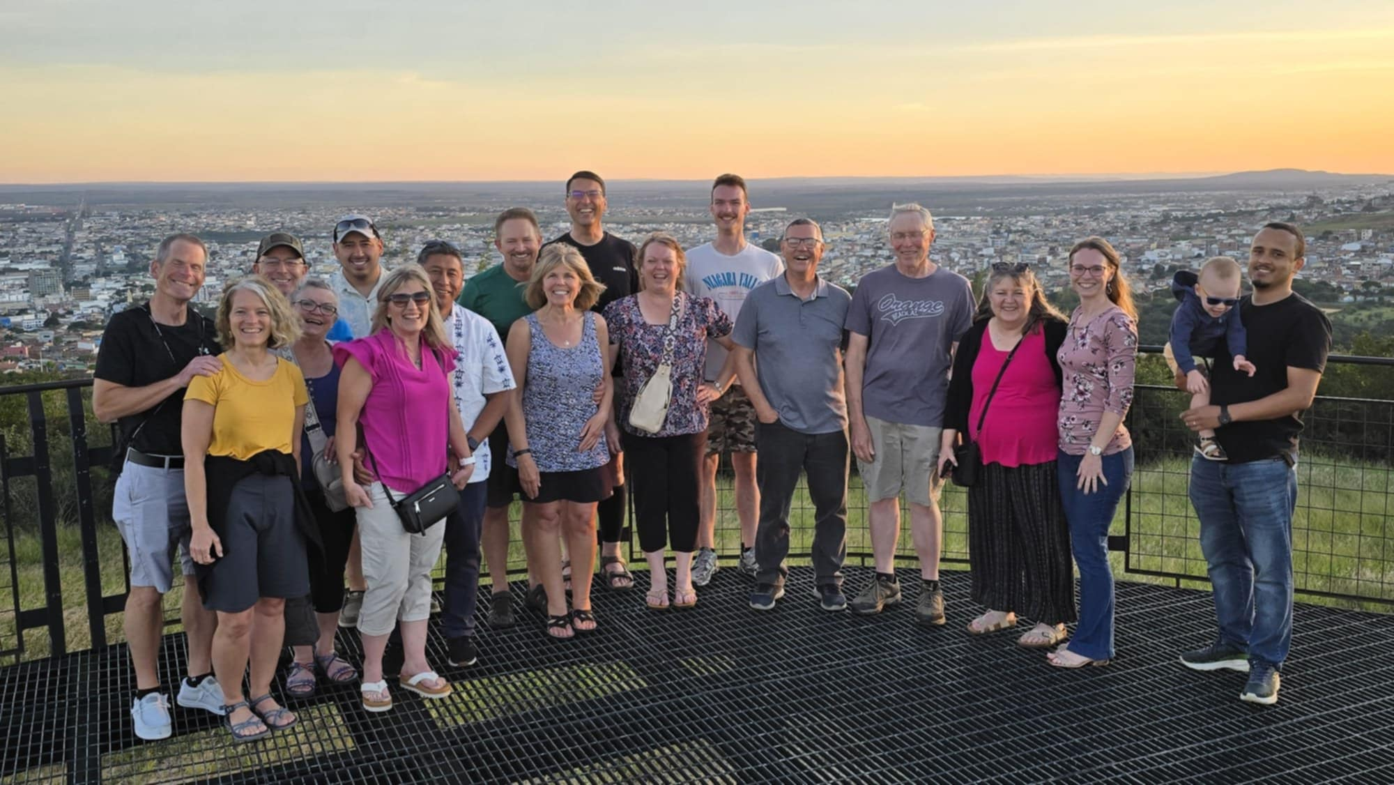

Slide 15
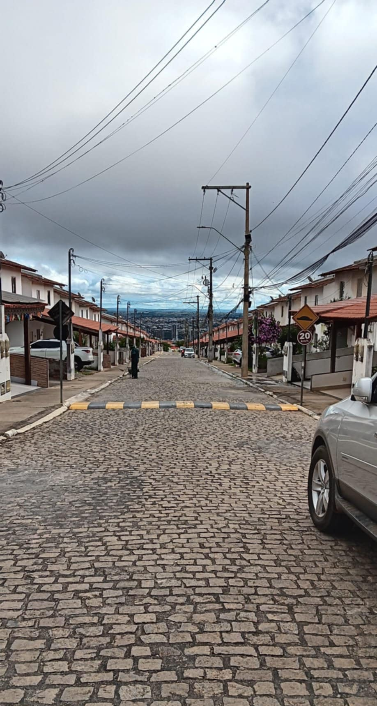
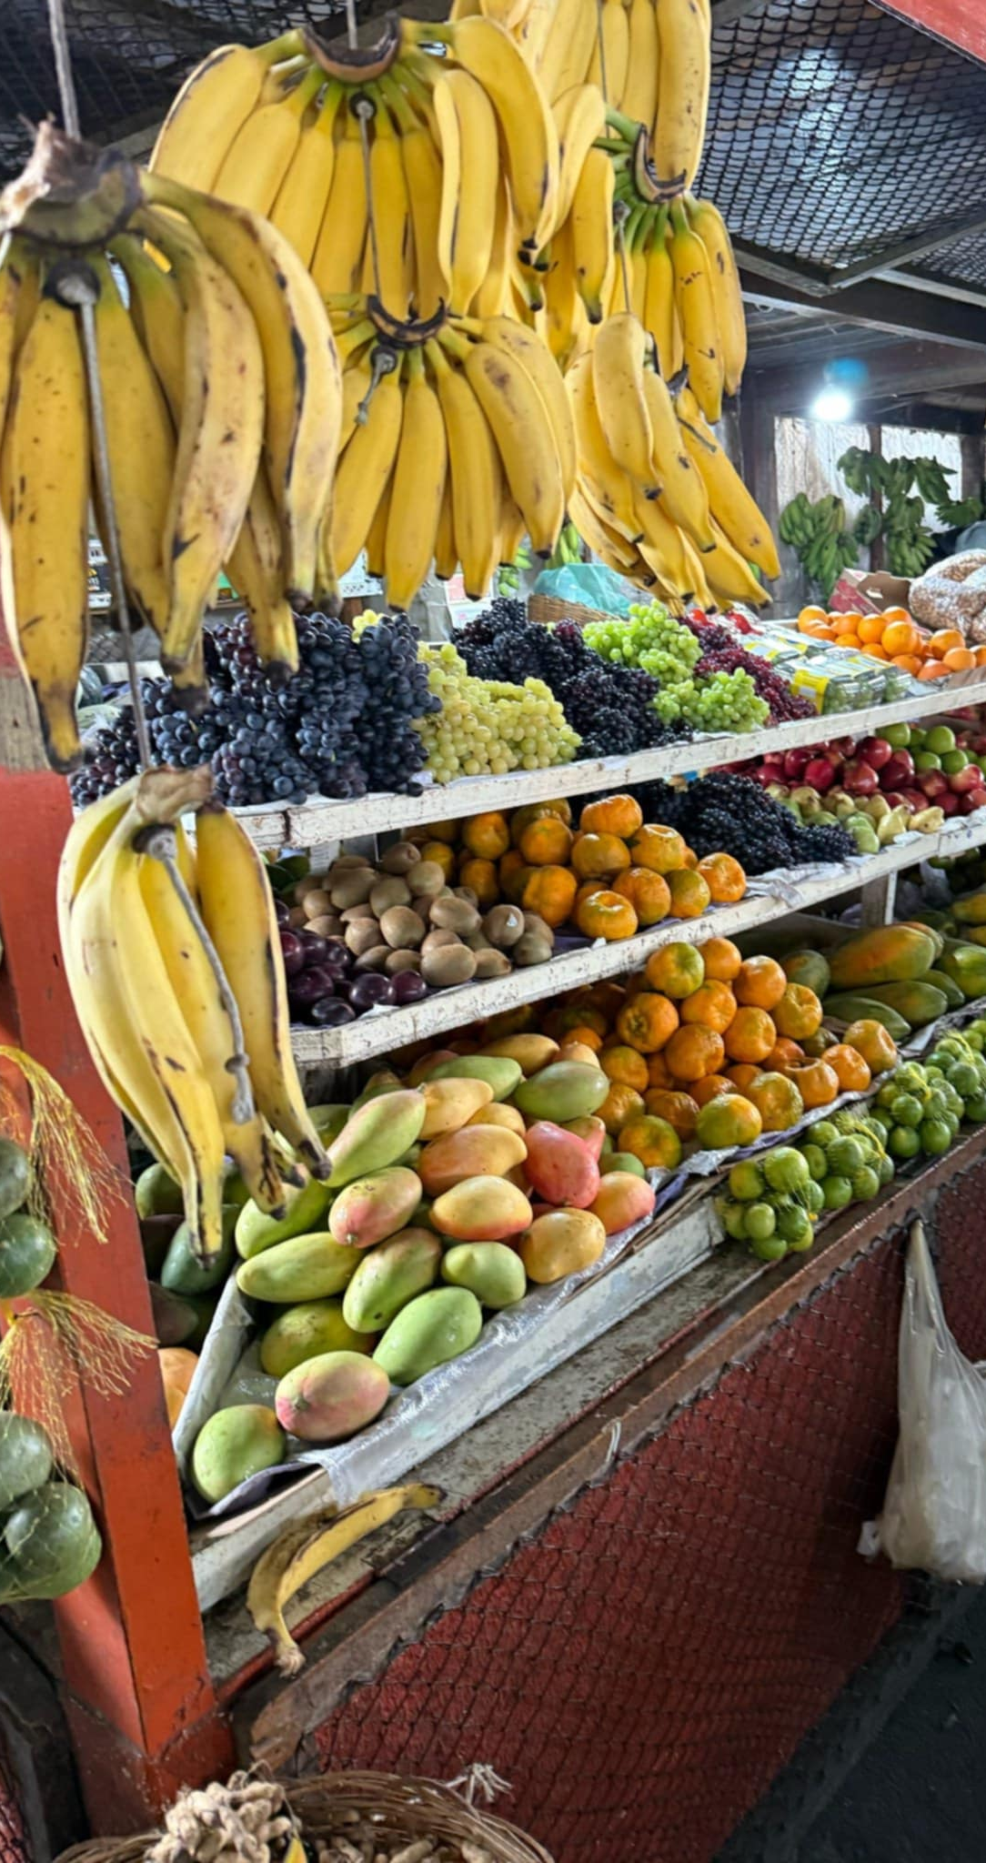
Right: OPEN-AIR MARKETS
Left: SPEED BUMPS
They were everywhere – they are called, “quebra molas” (i.e., break your shocks) and a method for speed-control

Slide 16
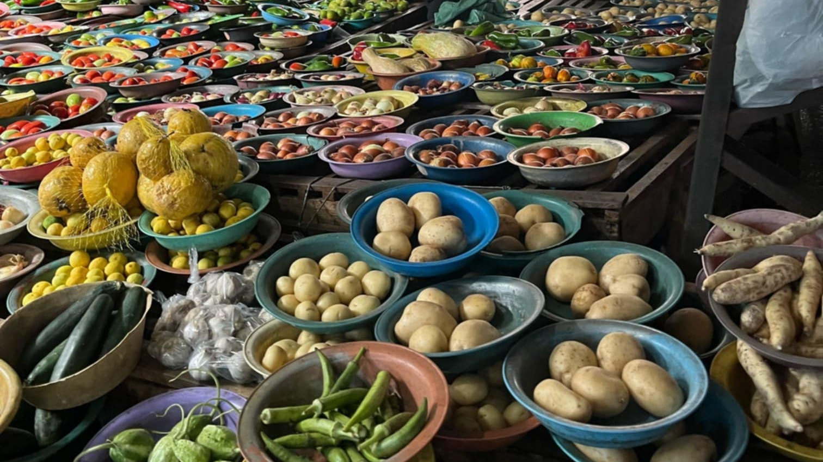

Slide 17
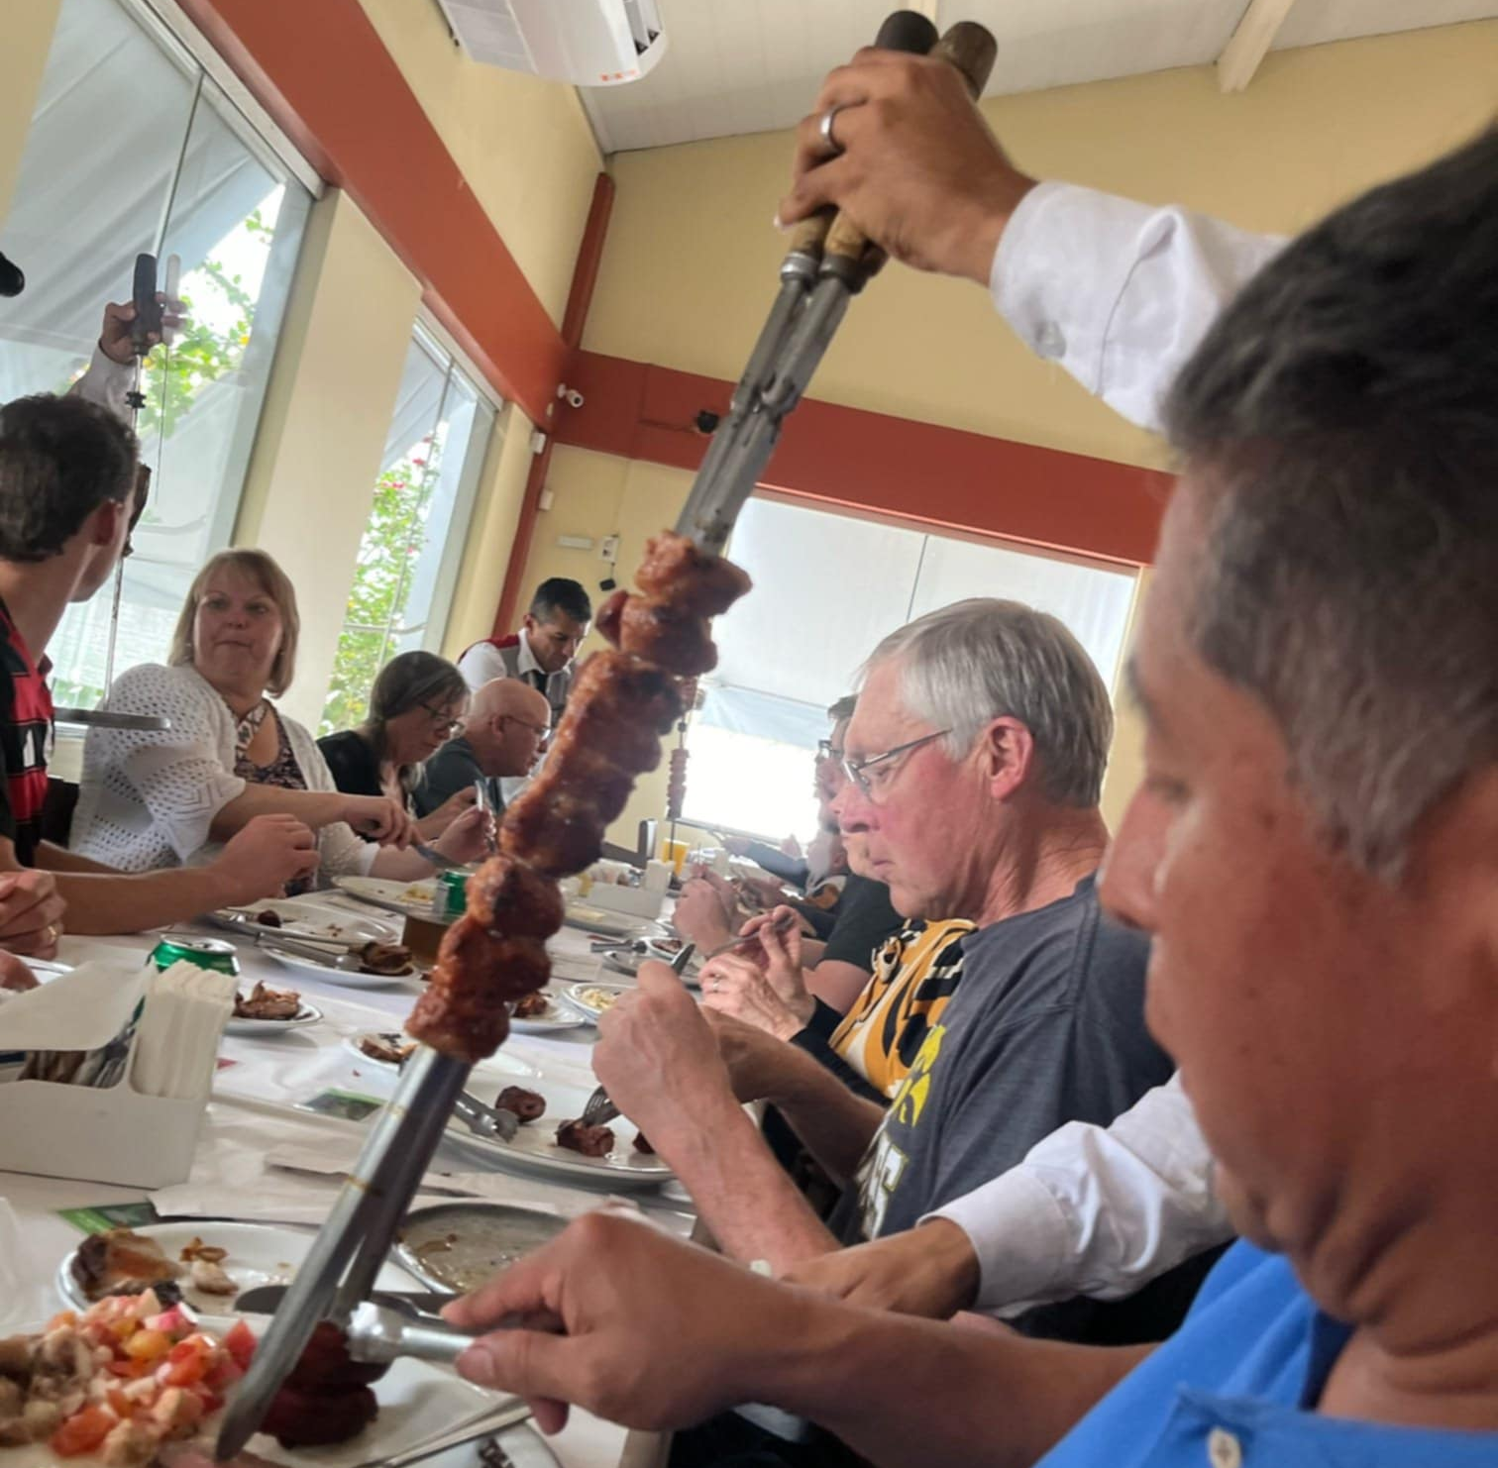
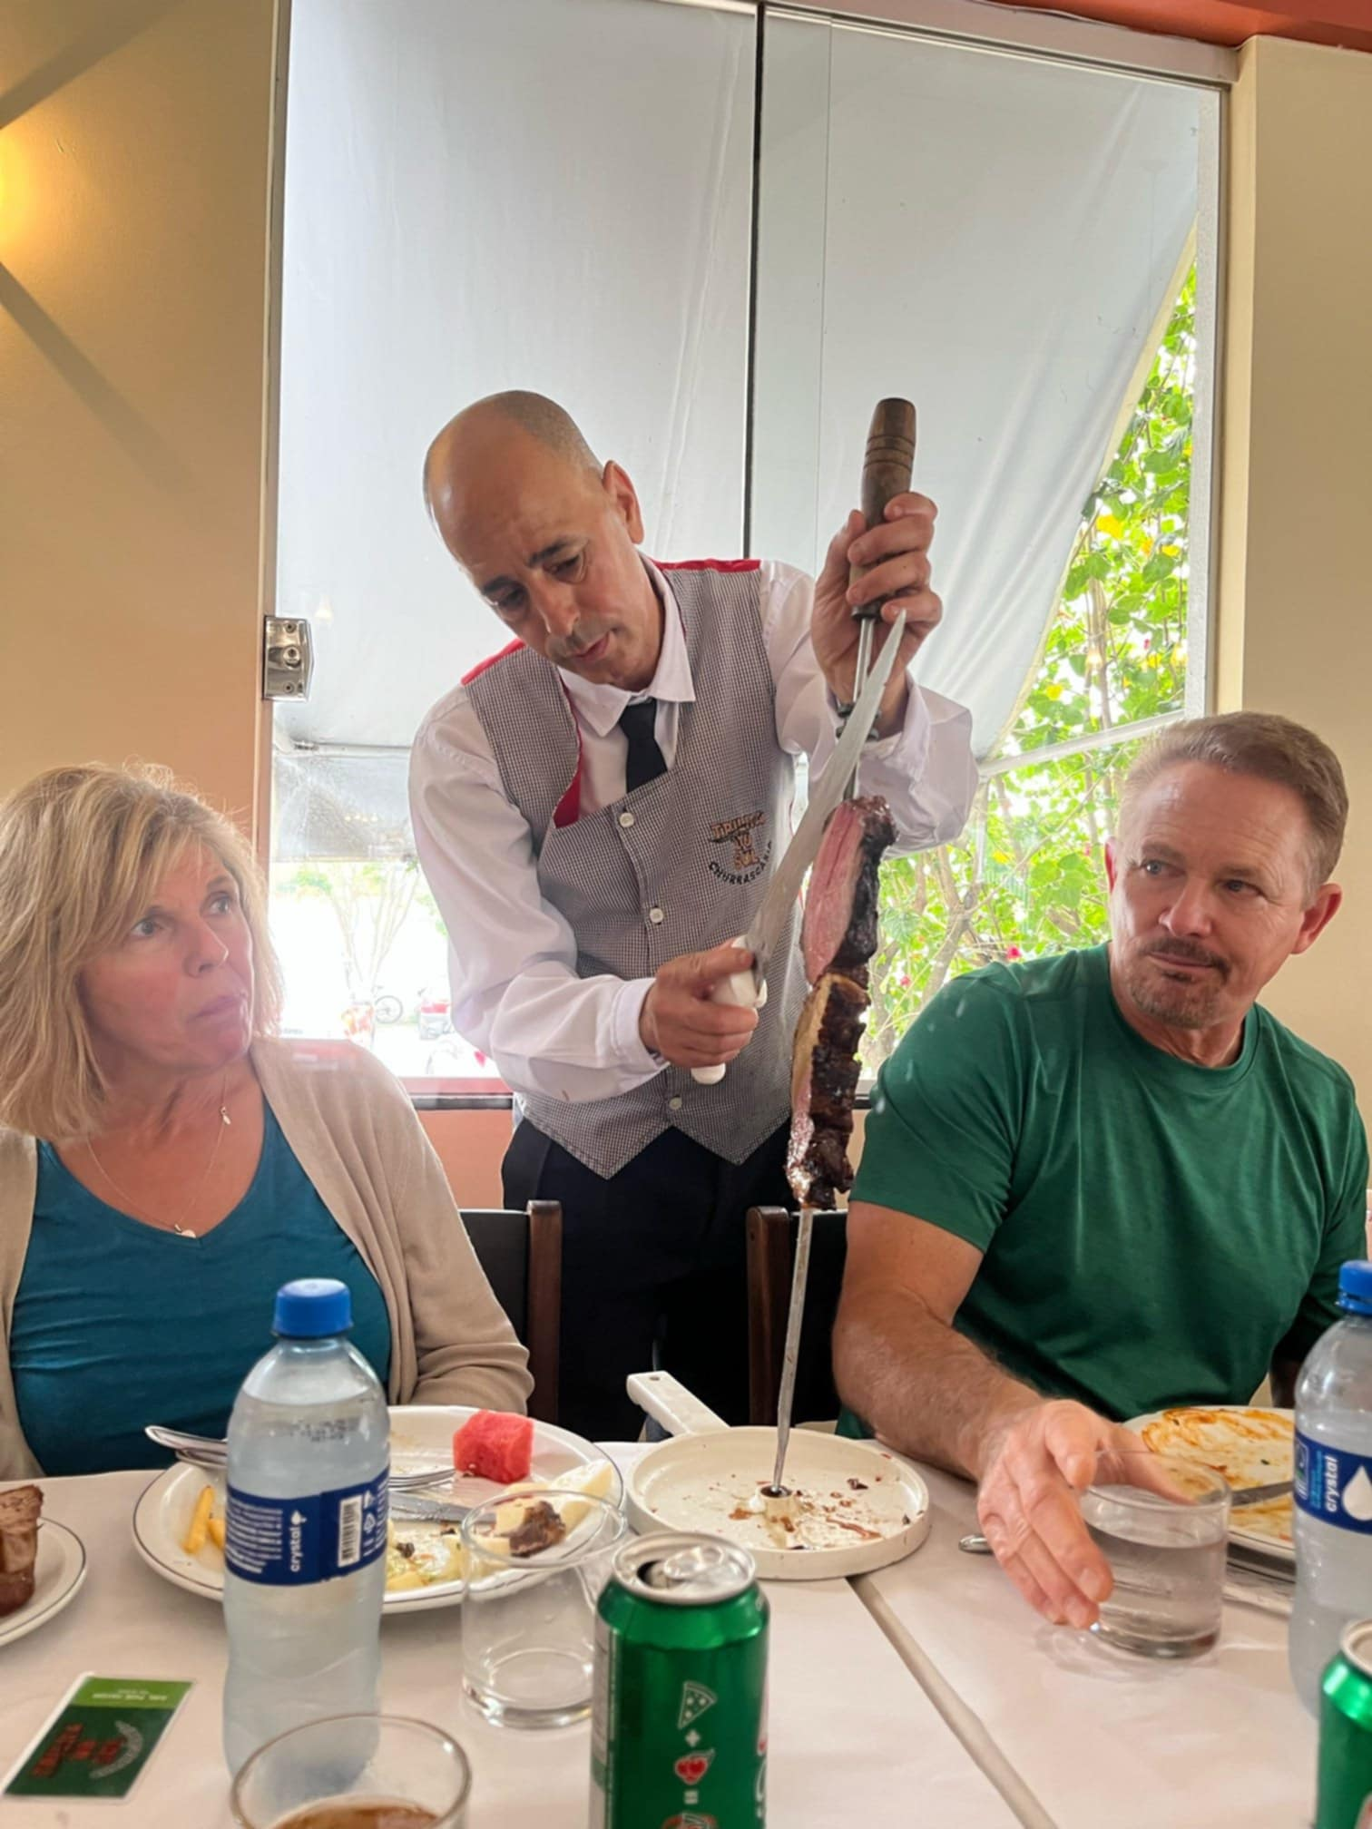
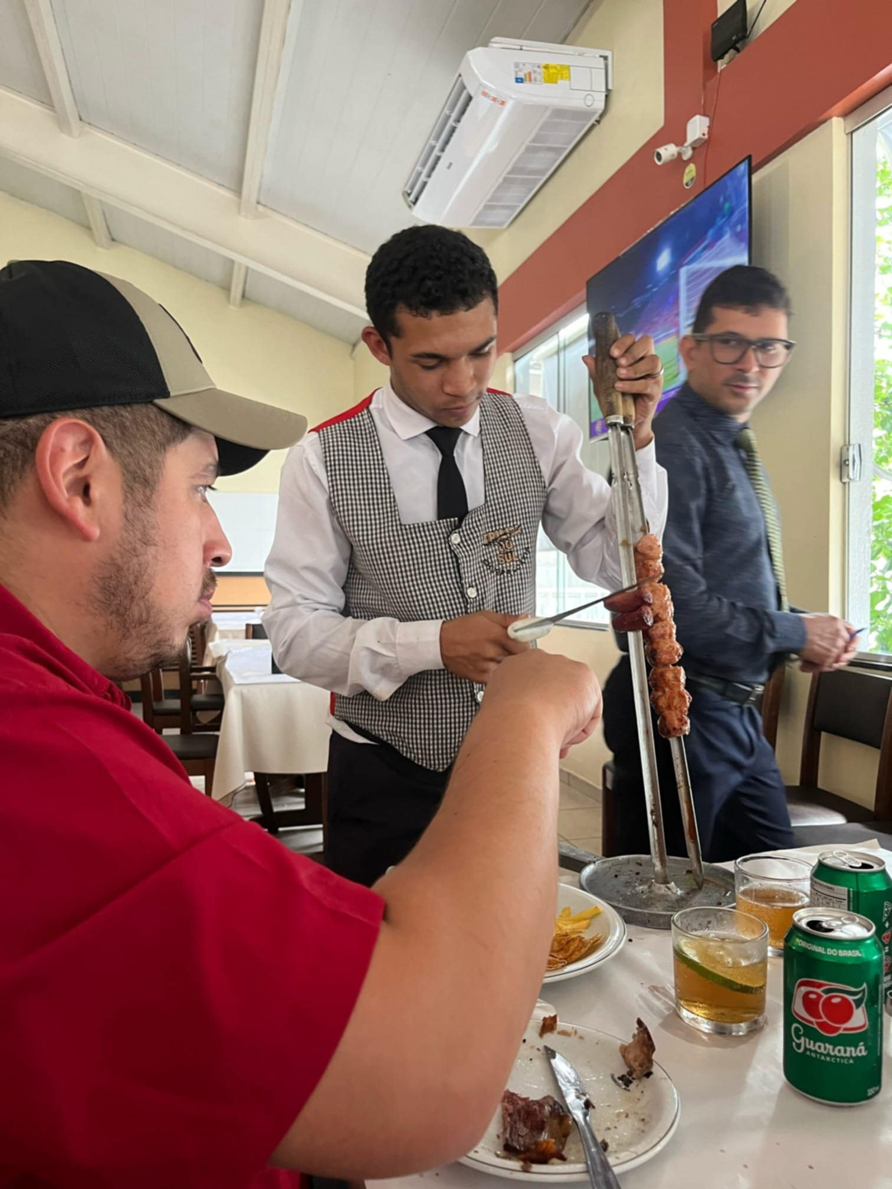
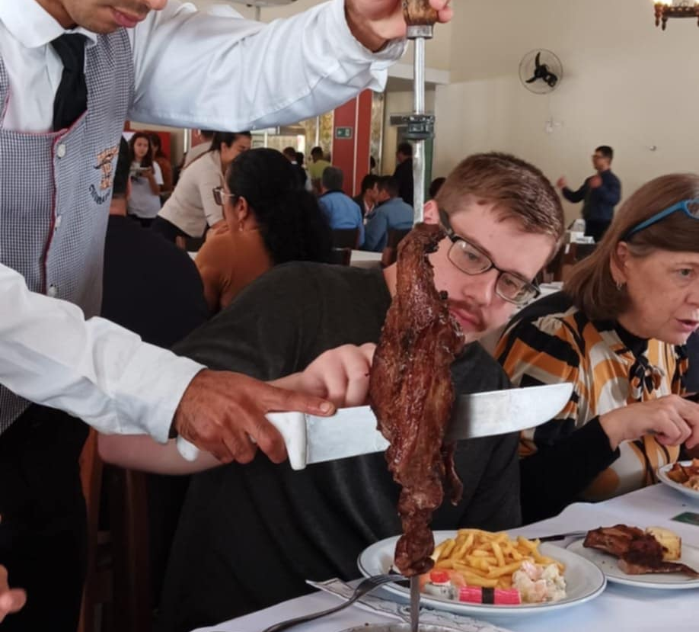
“CHURASSCO” (i.e., Brazilian Barbecue restaurant)

Slide 18
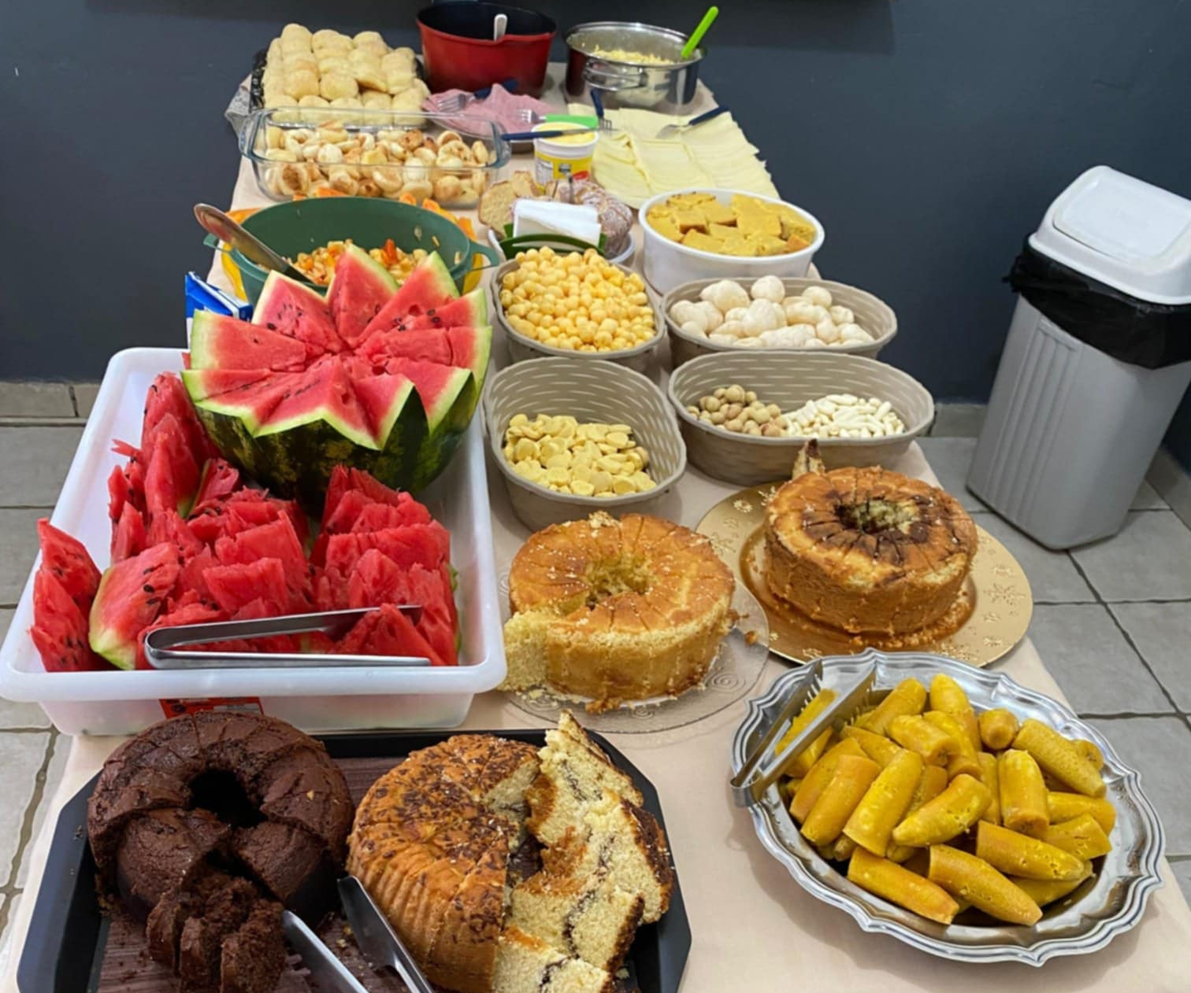
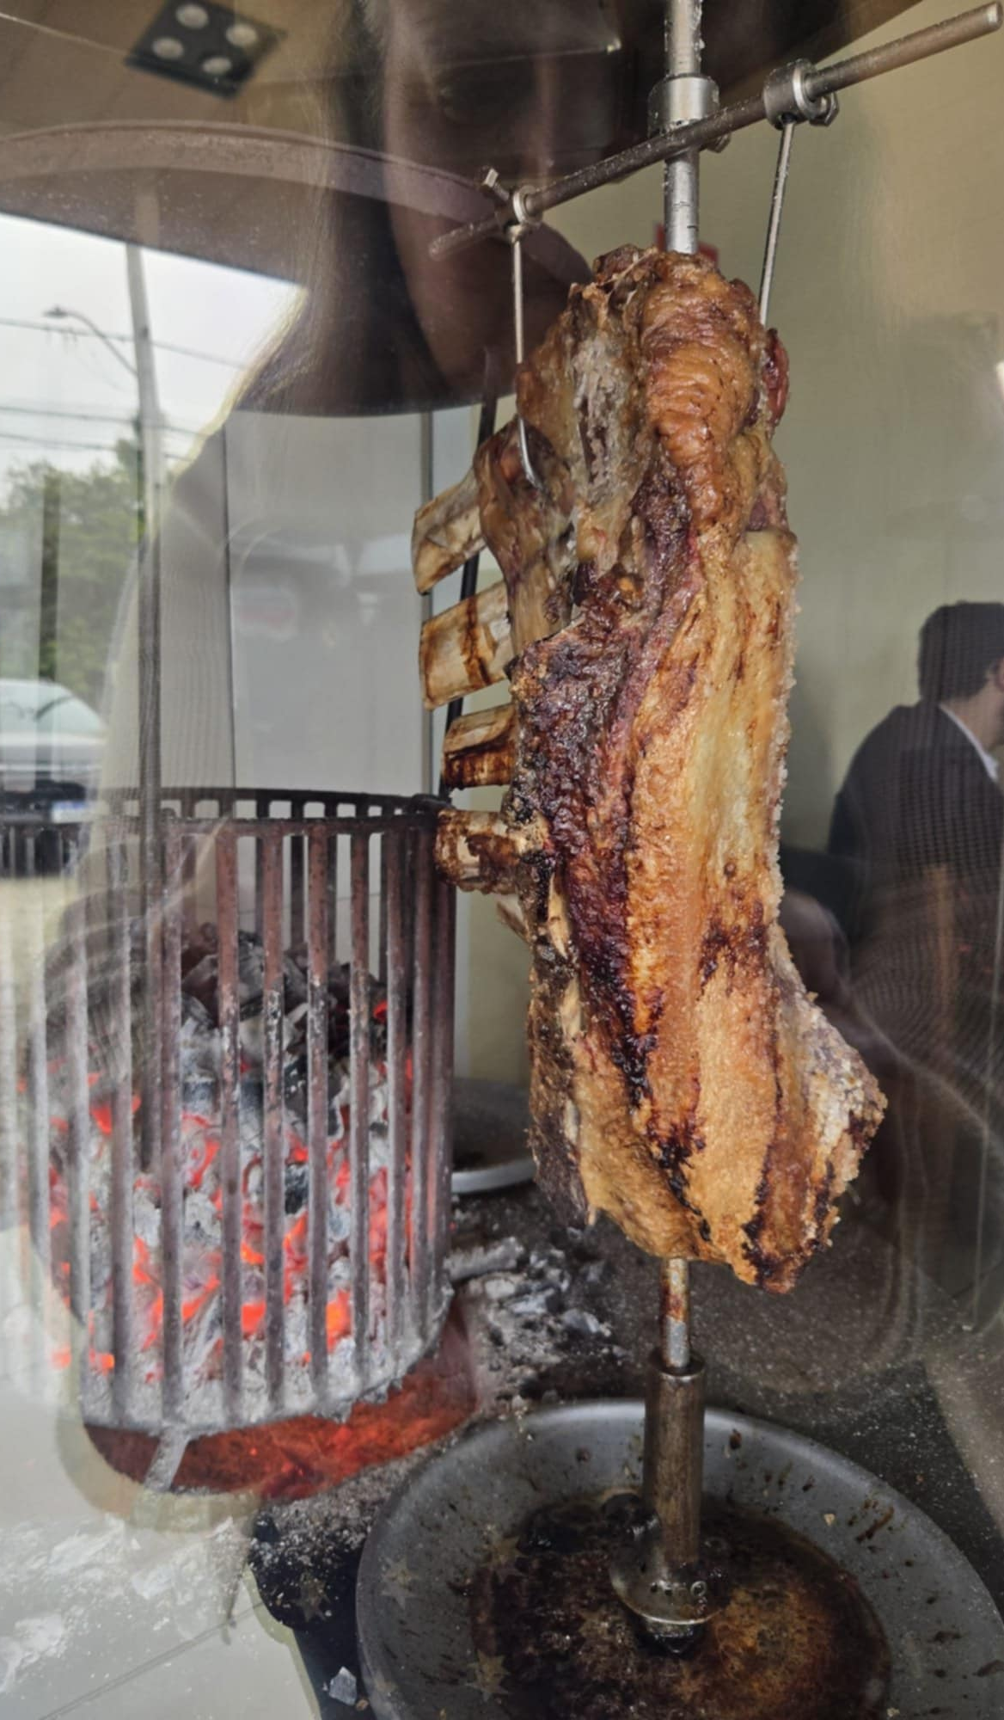

Slide 19
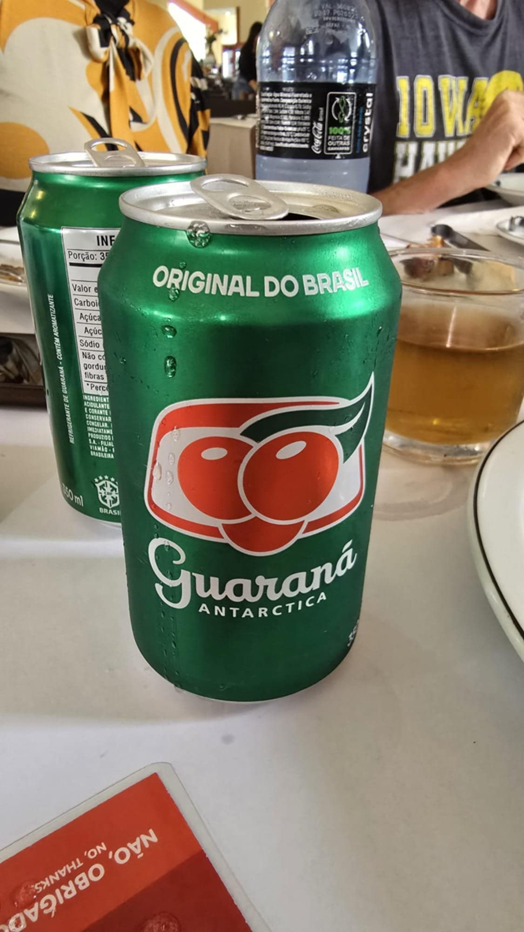
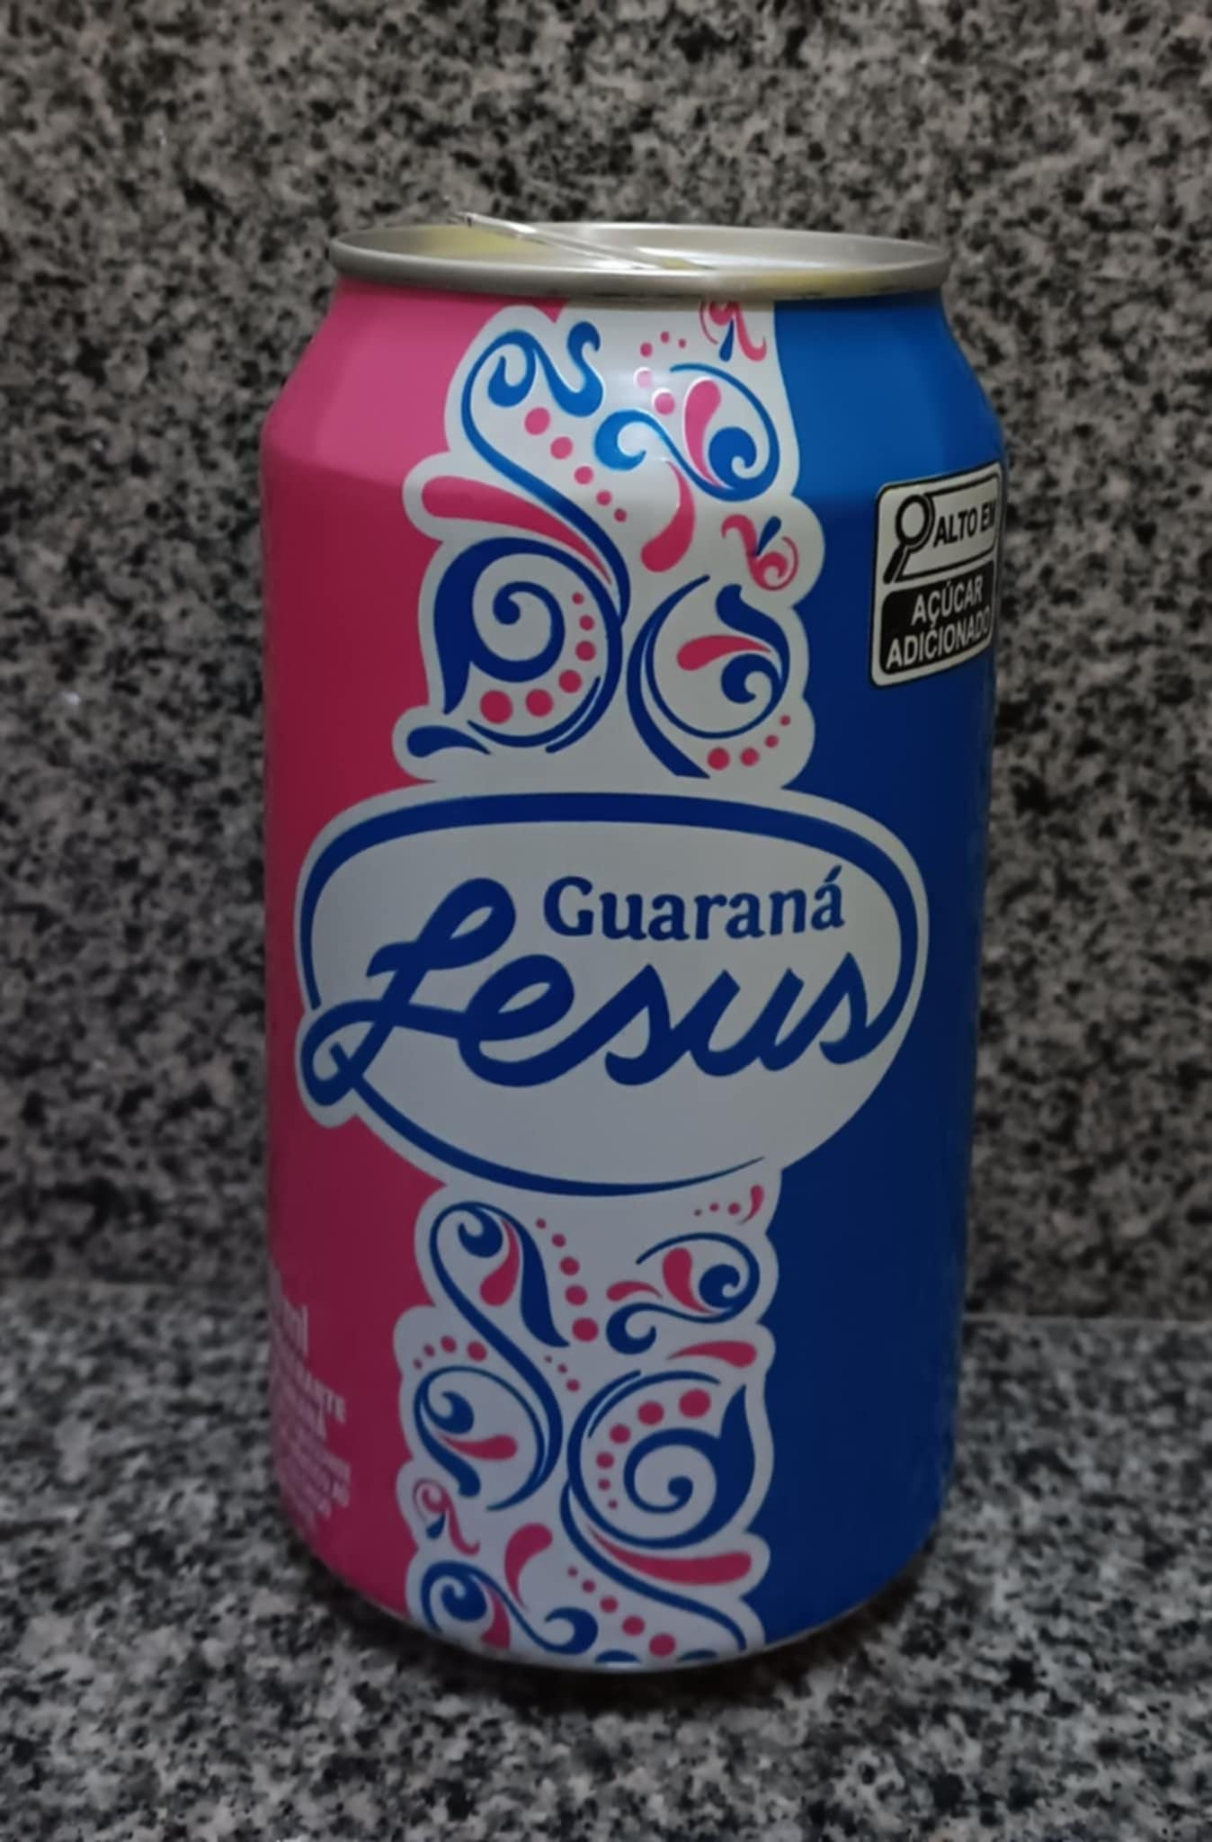
“GUARANA” – the favored pop in Brazil!

Slide 20
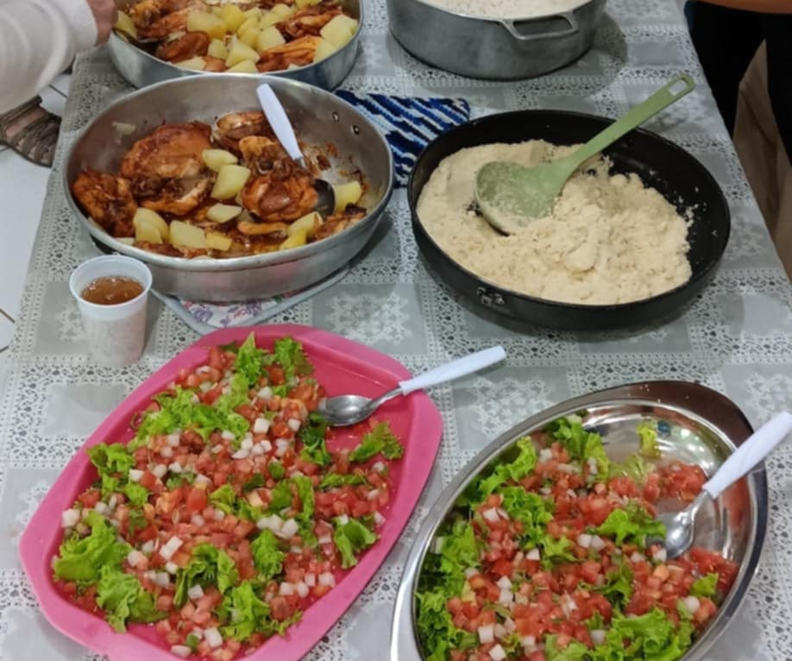
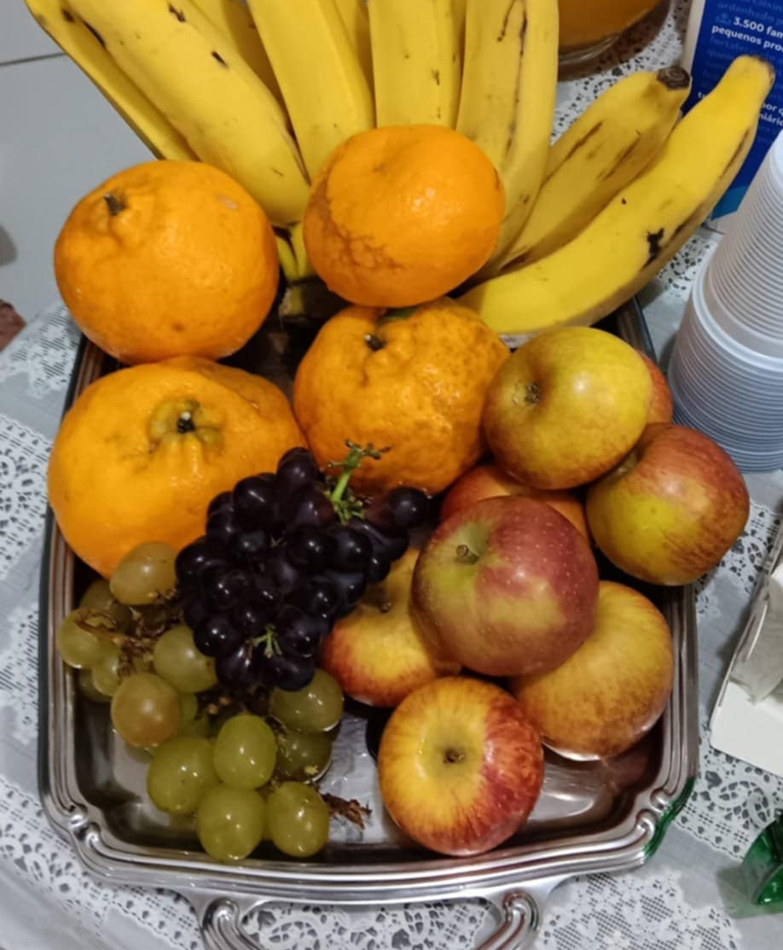
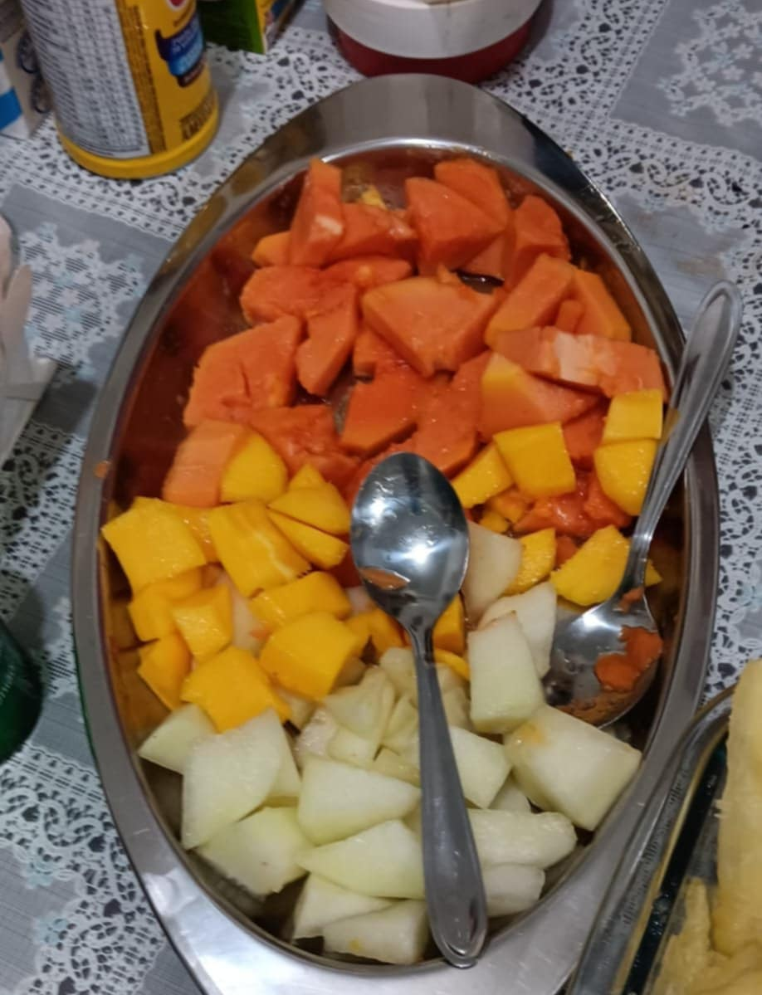
JOELIA’S DELICIOUS FOOD PREPARED ALMOST DAILY FOR US!

Slide 21
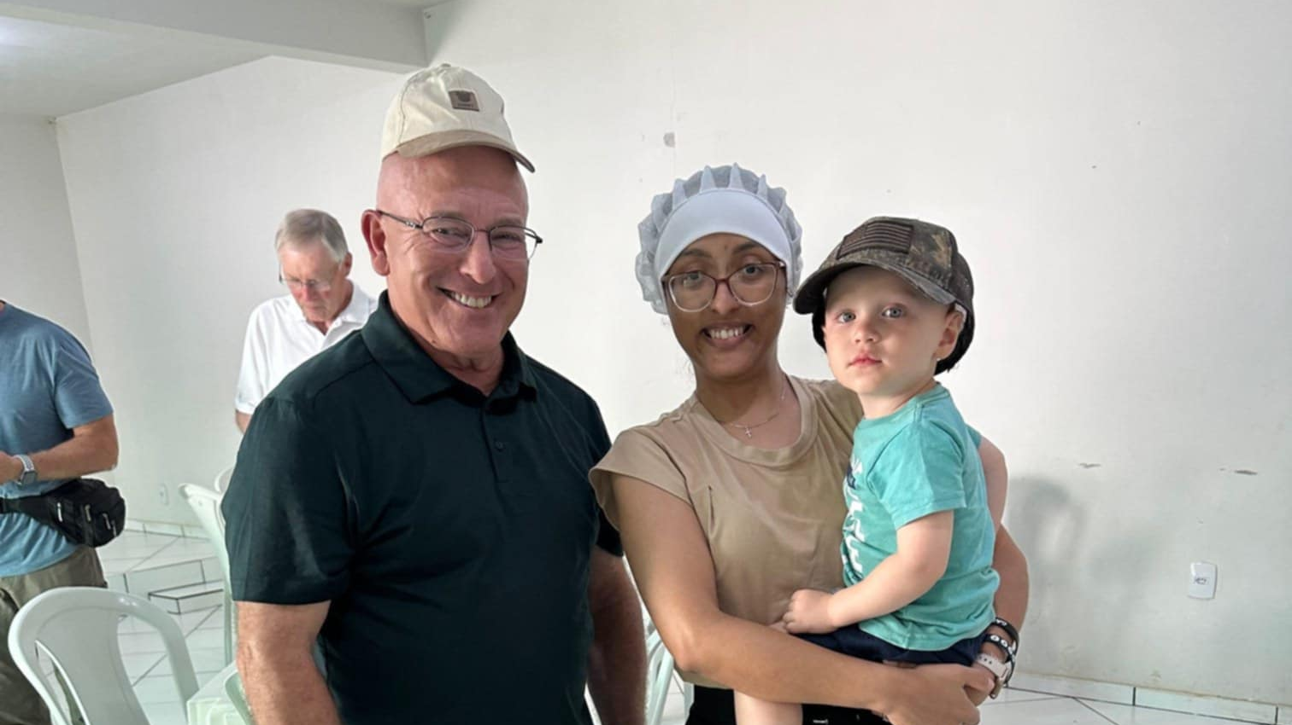
Helen, Victor’s sister who helped in the kitchen
Oliver, Victor & JoAnna’s son

Slide 22
SWEETHEART BANQUET – JUNE 7

Slide 23
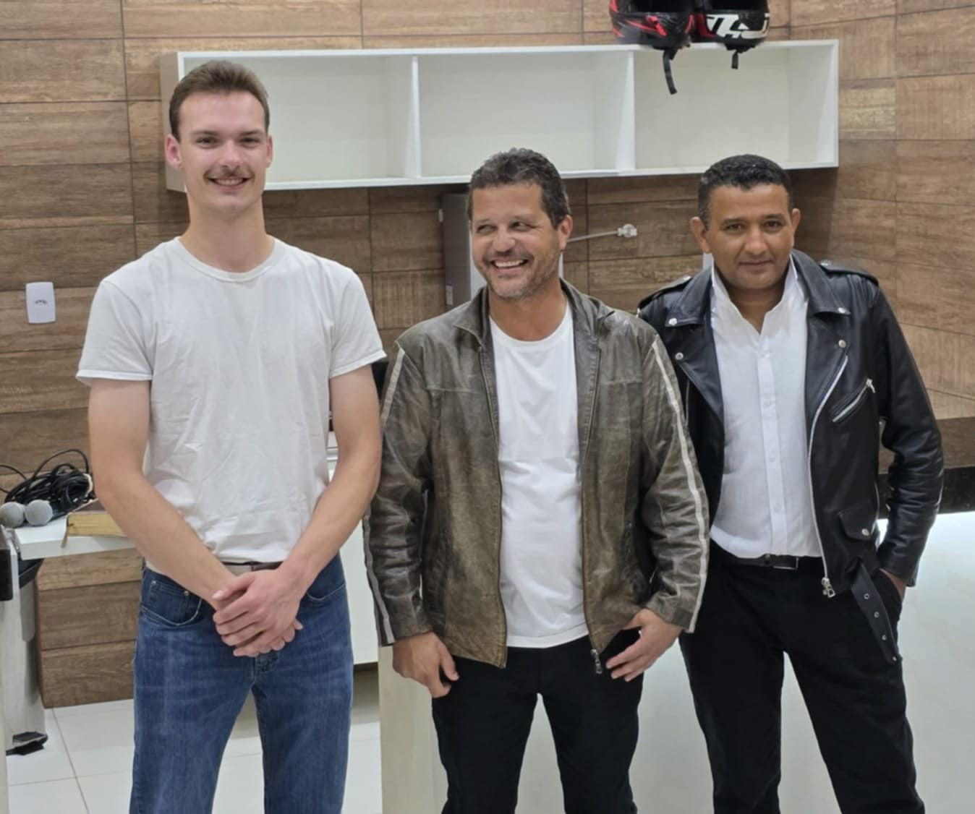
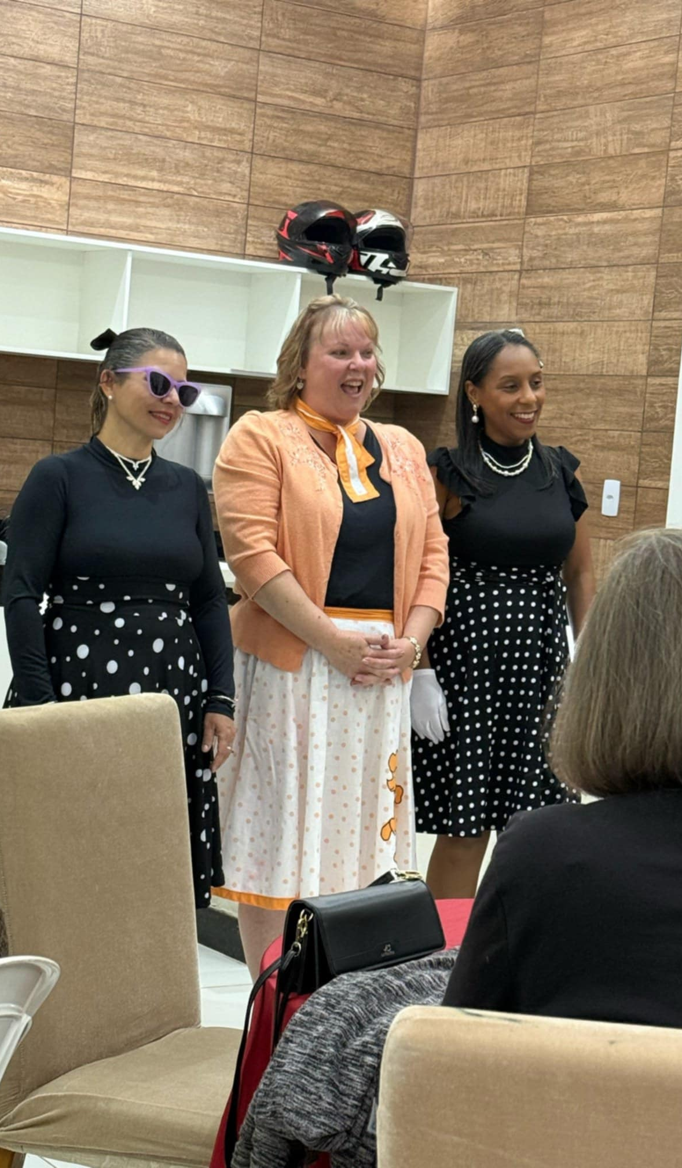
BOTH MICHAEL & CRISTINA WON 2nd PLACE FOR BEST-DRESSED 50’s STYLE!

Slide 24
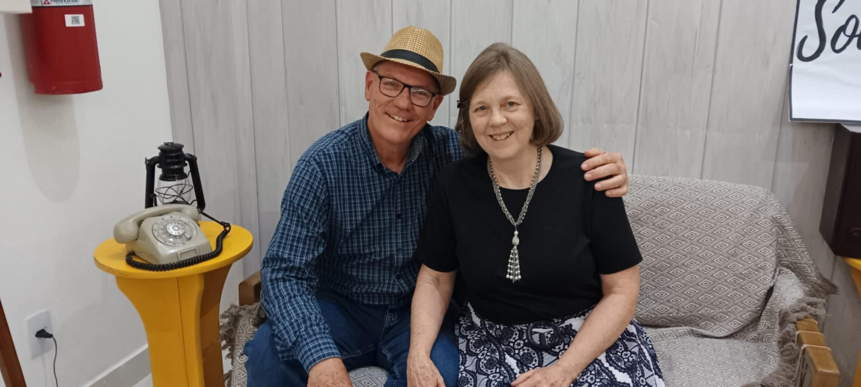
OUR WONDERFUL HOSTS, DAVID & DEBBIE THOMPSON – (Sweetheart Banquet – 50’s style)

Slide 25
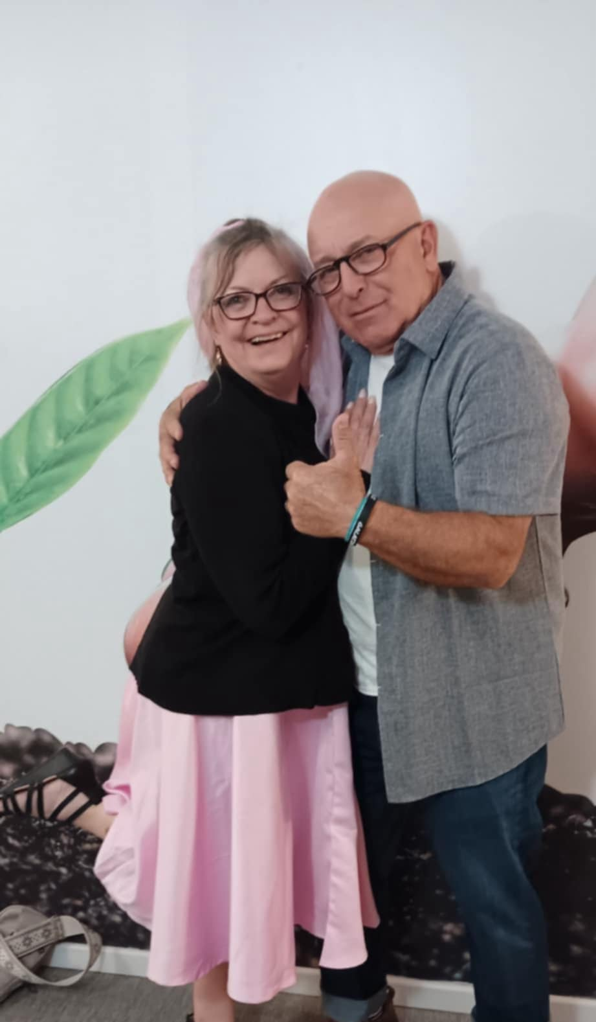
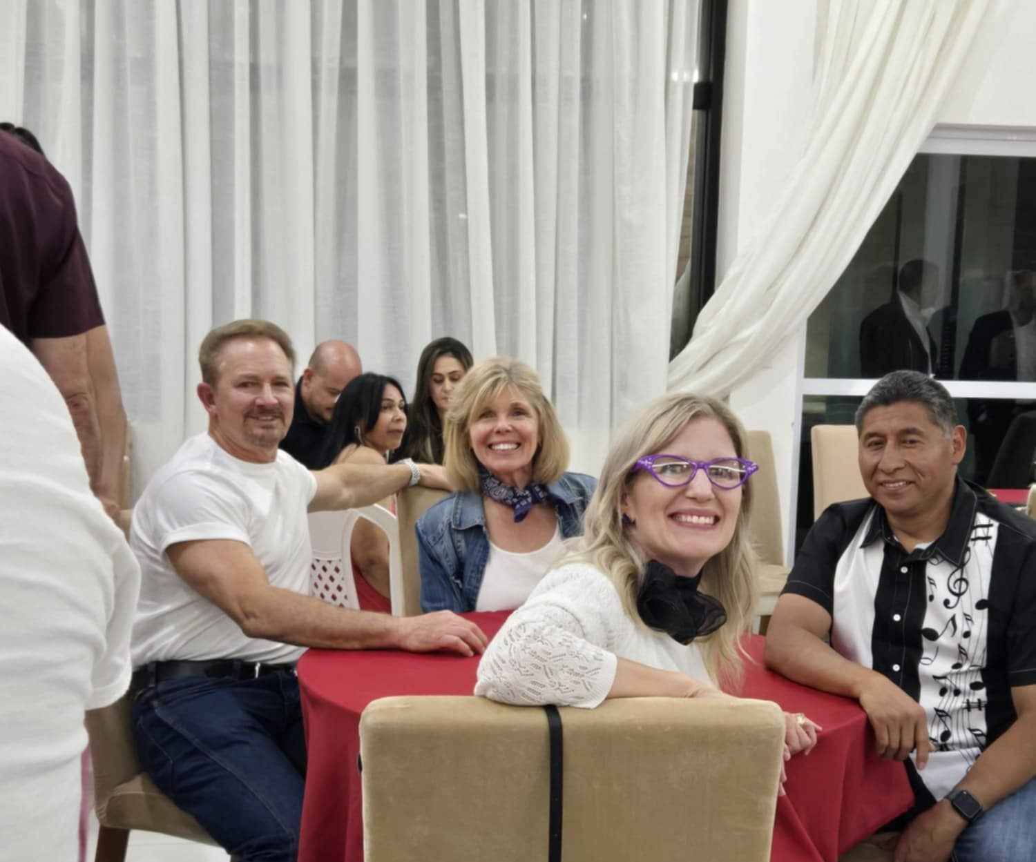

Slide 26
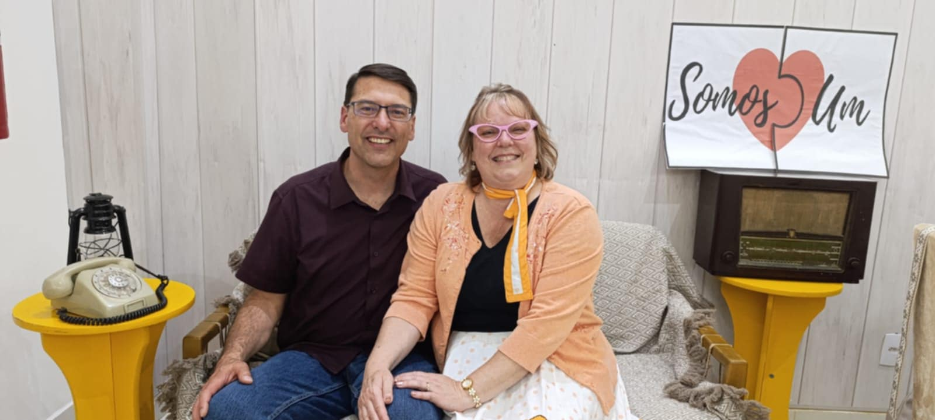

Slide 27
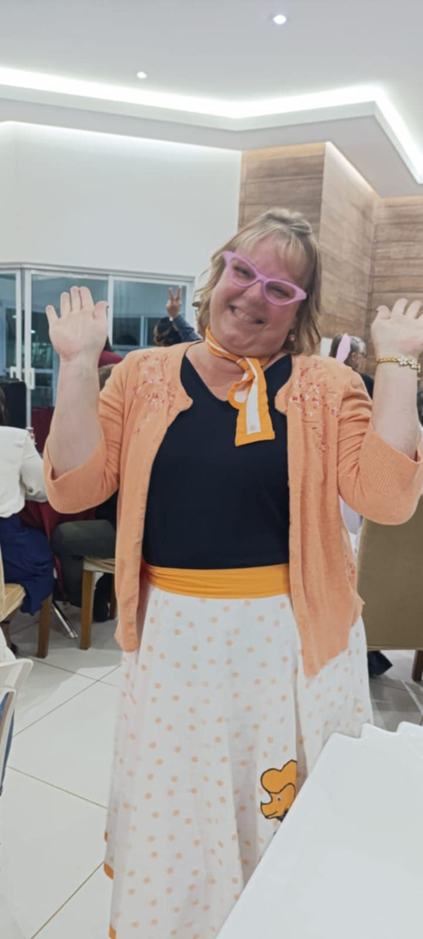
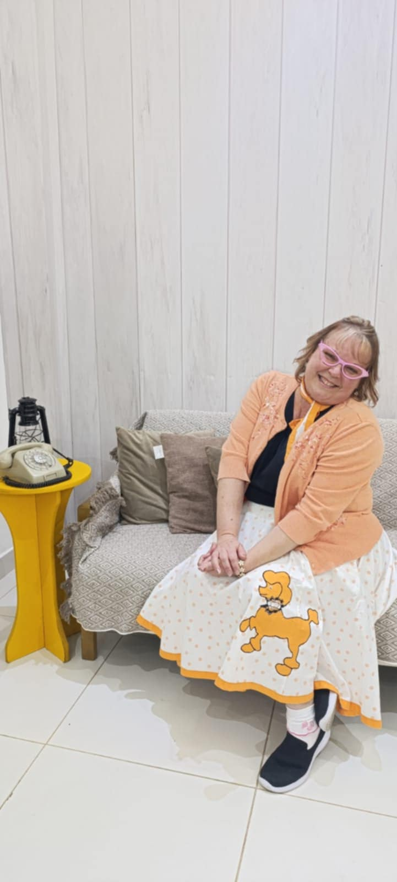

Slide 28
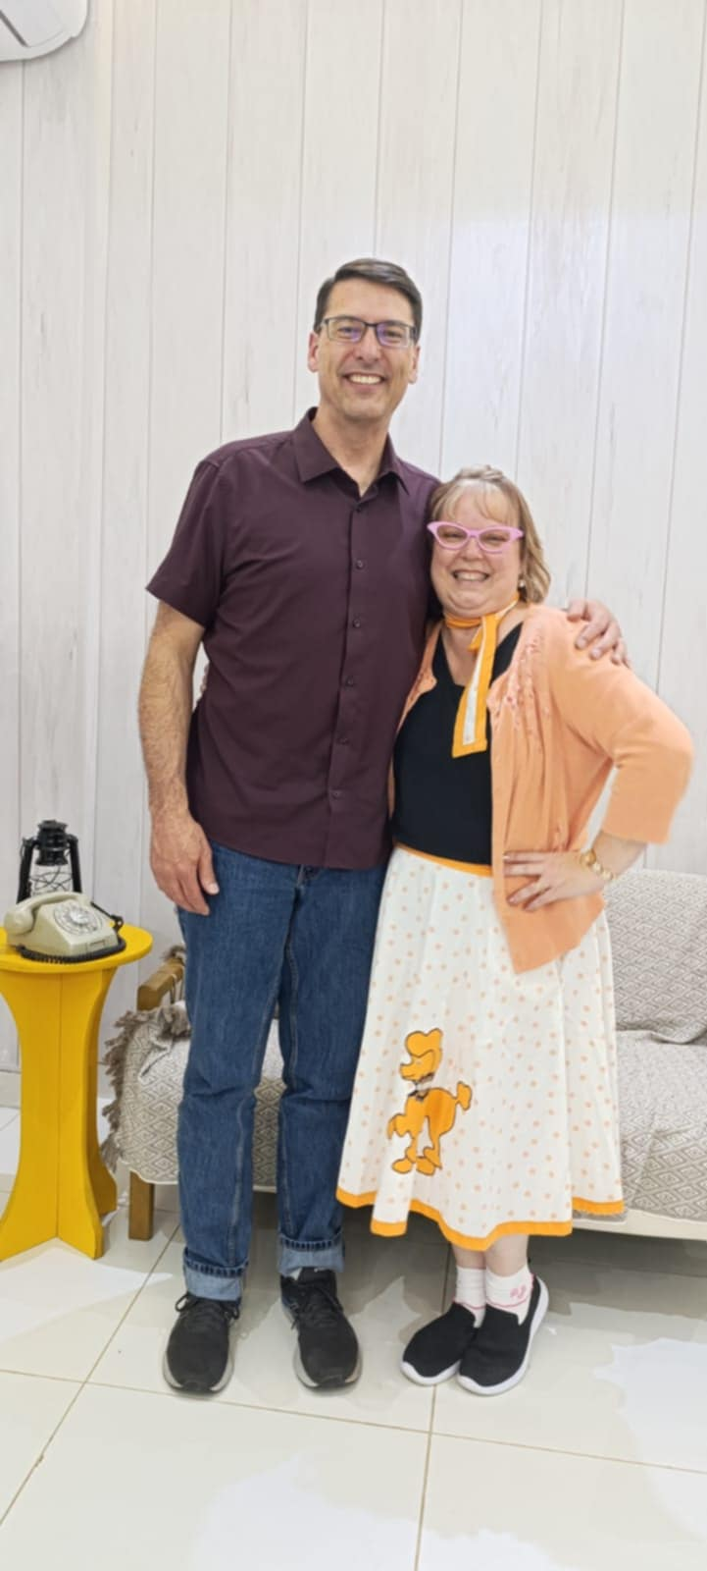
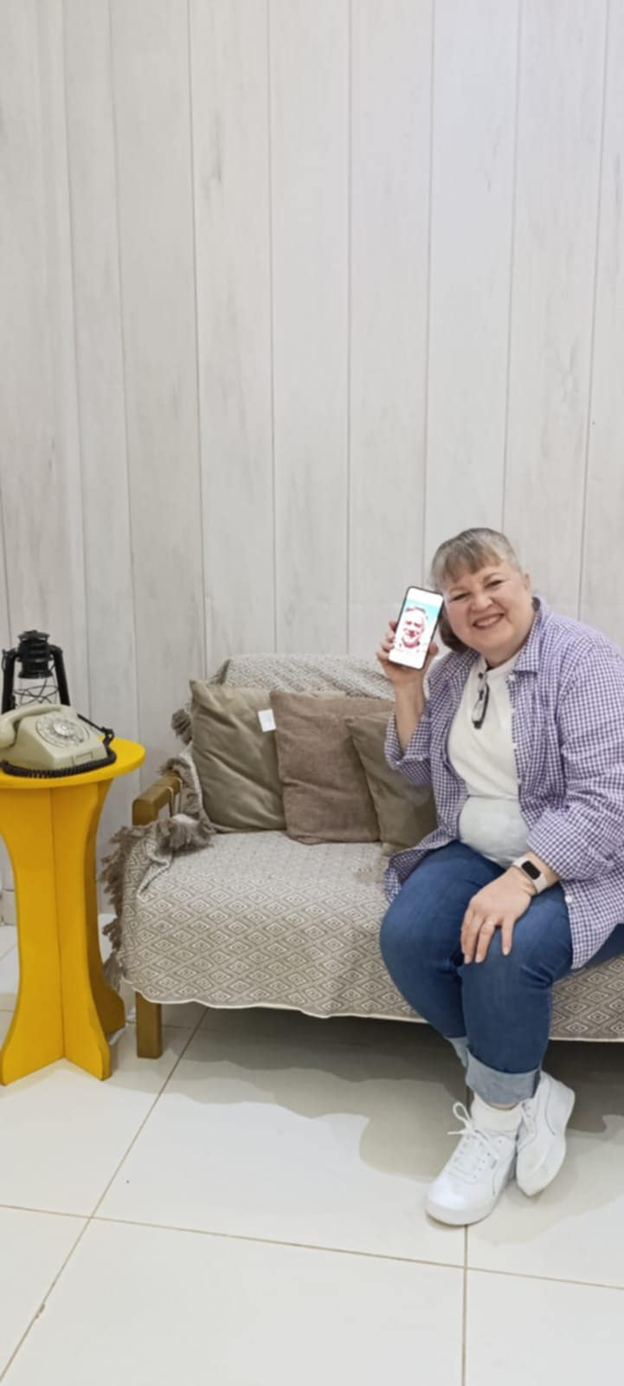
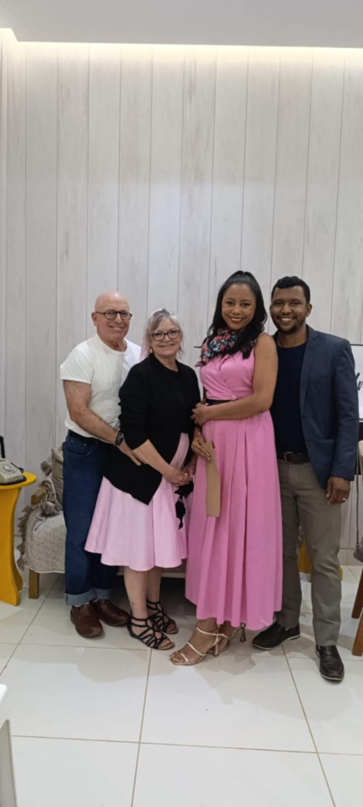

Slide 29
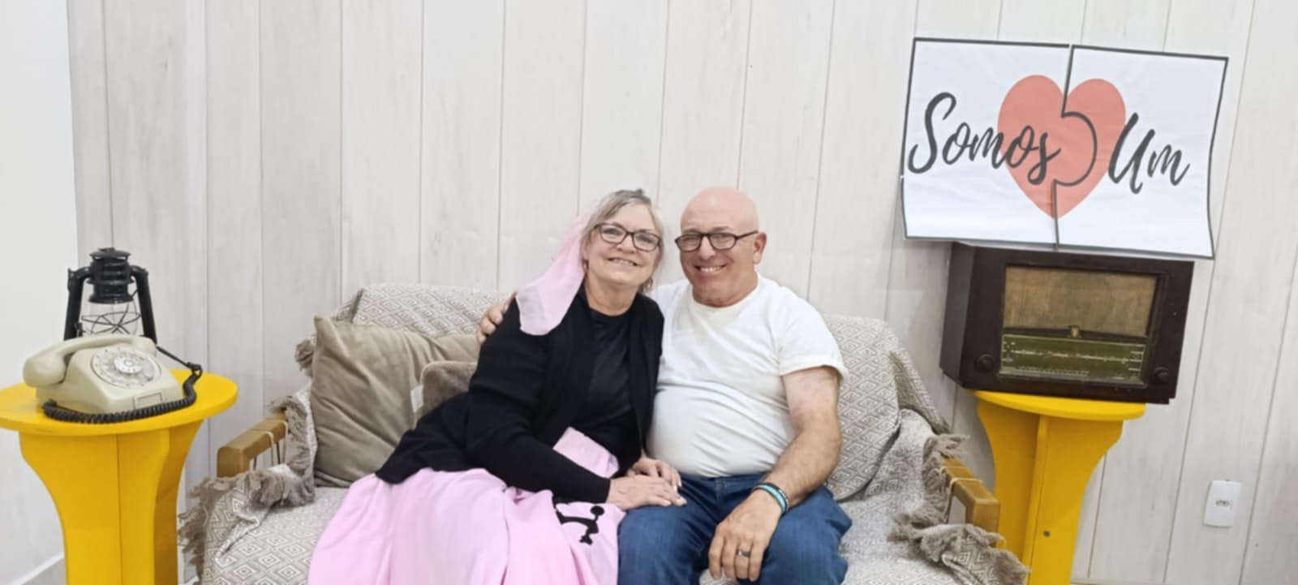

Slide 30
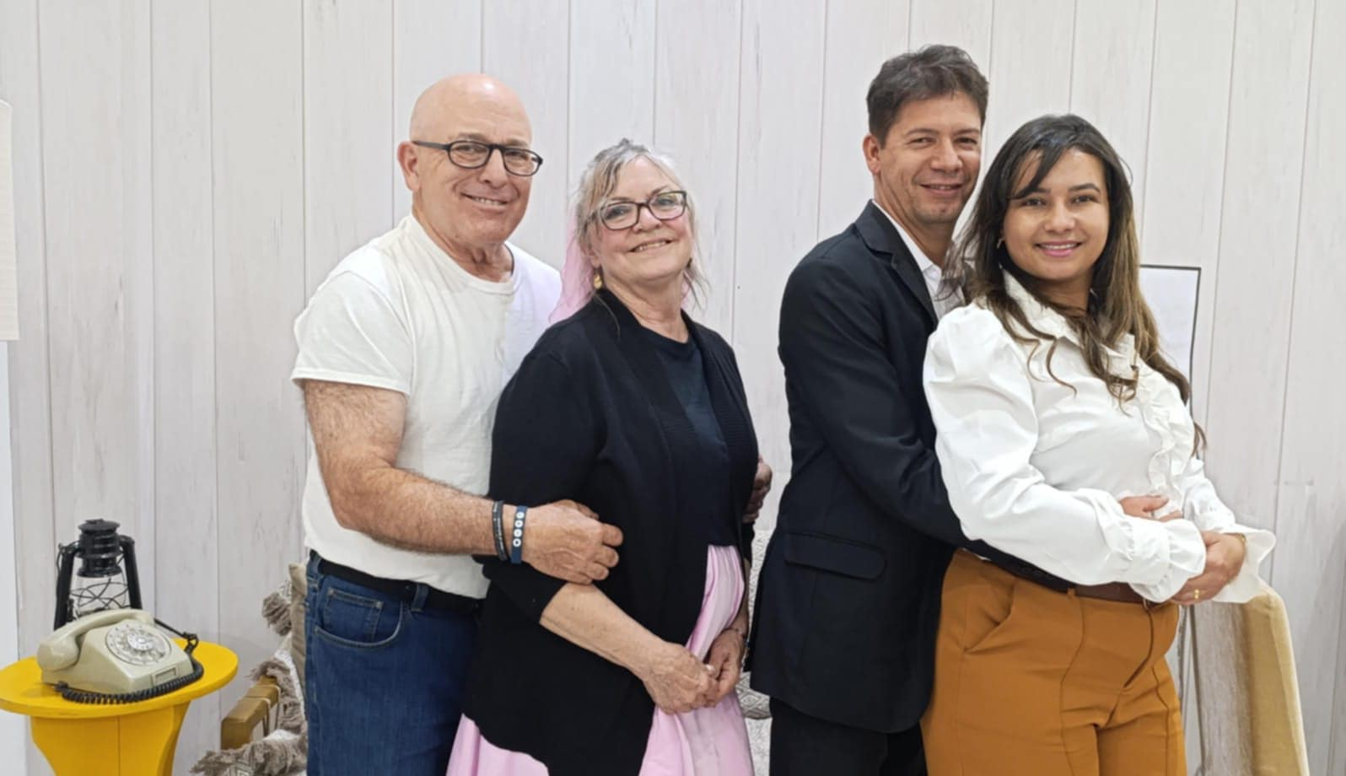

Slide 31
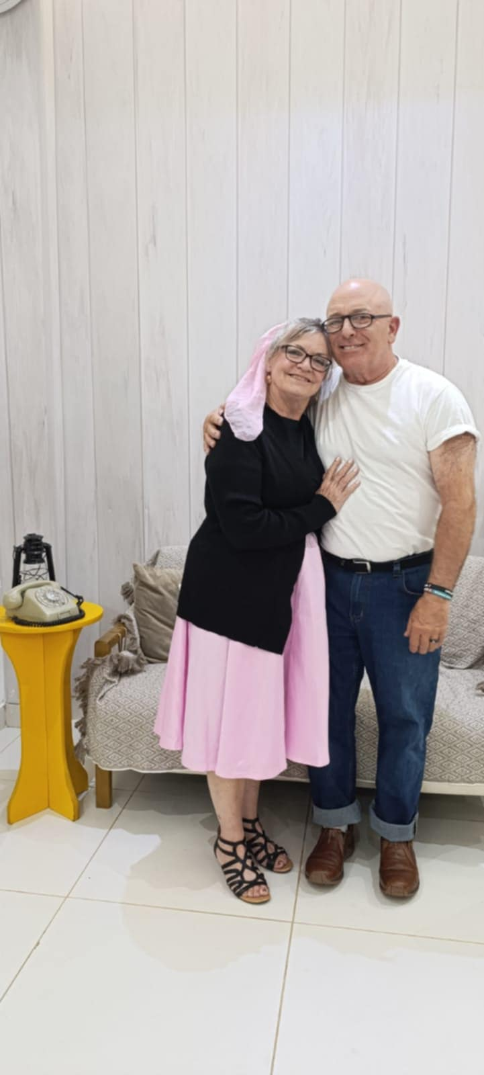
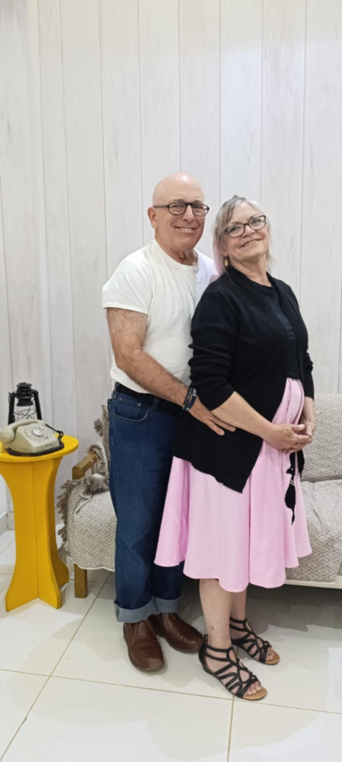

Slide 32
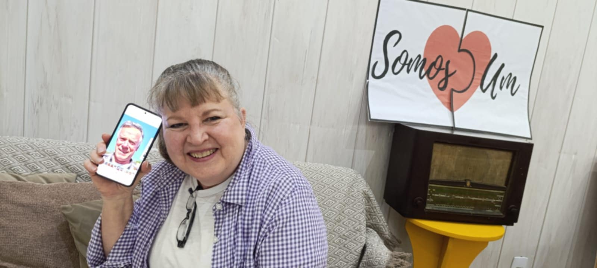

Slide 33
TESTIMONIES

Slide 34
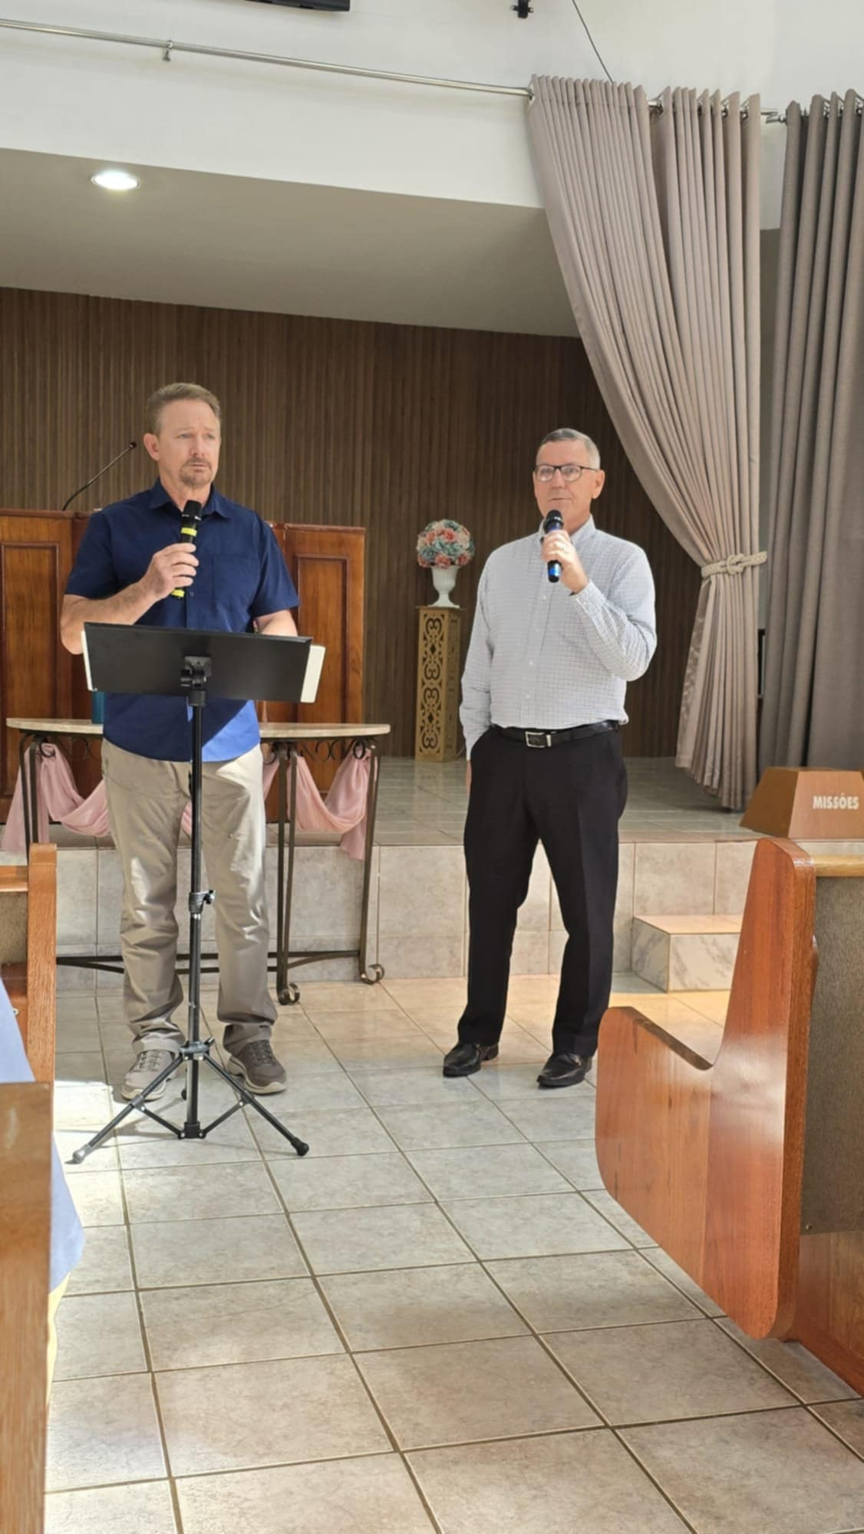



Slide 35




Slide 36





Slide 37




Slide 38
ILHEUS BEACH
(Atlantic Ocean)

Slide 39



BEACH TIME @ ILHEUS

Slide 40


Slide 41


Slide 42


Slide 43


Slide 44


Slide 45



Slide 46




Slide 47



Slide 48





Slide 49



Slide 50

GROUP PICTURE @ ILHEUS BEACH

Slide 51


Ask them later about this…. ☺

Slide 52
THOMPSON THEOLOGICAL BIBLE SEMINARY
Founded March 1, 1968 by Bob & Alice Thompson

Slide 53



Cristina had the privilege of speaking about her parent’s legacy

Slide 54

Cristina spoke in English so the team could understand, and David translated it into Portuguese for the Seminary students; this was a significant and emotional evening for Cristina!

Slide 55


Slide 56
ALICE THOMPSON CHRISTIAN GRADESCHOOL
COAT = CO – Colegio | AT – Alice Thompson
Inaugurated by Alice Thompson in June 2017
Opened in February 2018 with 57 students
As of June 2025, there are 346 students!

Slide 57




Slide 58

THE CHILDREN AT “COAT” – ALICE THOMPSON GRADESCHOOL

Slide 59



Slide 60




Slide 61



Slide 62


Slide 63



Slide 64

I.E., “Christian Education for Life”

Slide 65

DEBBIE THOMPSON’S BIRTHDAY!

Slide 66


Mike’s fashion statement while in Brazil!

Slide 67
CHURCHES

Slide 68

“GOODNESS OF GOD” with Valeria signing – at Calvario Church

Slide 69

“Holy Forever” by Chris Tomlin
Calvario Church (& baptism)

Slide 70


Slide 71


Slide 72



Slide 73

BAPTISM AT CALVARIO CHURCH ON SUNDAY, JUNE 8th
(The baptistry was way up high; and Brazilians were singing in Portuguese,
“Holy Forever” by Chris Tomlin)

Slide 74

URBIS I CHURCH
(The original church the
Thompsons planted)

Slide 75


Slide 76


Slide 77

URBIS I CHURCH
Jacque, whom we met in 2013, and is now married and very faithful at the Urbis I Church
Natalia, Jonathan’s wife

Slide 78

“MORADA DOS PASSAROS” CHURCH –
AND ALSO SEMINARY CHAPEL / CHURCH

Slide 79


Our group’s donations will complete the stage / pulpit area of the Primavera Church!
Ours was the FIRST meeting they held in the newly built Sanctuary!

Slide 80




Slide 81





Slide 82

POCOES CHURCH – 1 hr.’s drive from Conquista

Slide 83

POCOES CHURCH

Slide 84

FUTURE SITE OF POCOES CONGREGATIONAL CHURCH

Slide 85

POCOES CONGREGATIONAL CHURCH CONSTRUCTION

Slide 86



Slide 87


Slide 88

LAGOA DE TIMOTEO CHURCH – 1 HR. OUT OF CONQUISTA

Slide 89

Pastor Augusto & Dayane are ministering twice per month at Lagoa; this church needs a full-time pastor and they asked us to pray accordingly for God’s provision!

Slide 90

David sharing the humble beginnings of this church and how God directed him to help start this church!

Slide 91

LAGOA DE TIMOTEO CHURCH
(1 hr. out of Conquista)

Slide 92

LAGOA DE TIMOTEO CHURCH

Slide 93


BAPTISTRY
CLEAR PODIUM

Slide 94



Slide 95

ORLANDO
(nickname is Loro)
And another convert named Joao (i.e., John) was also converted; he was drunk when he got saved! He quickly gave up his vices and decided to follow Jesus in Believer’s Baptism and is now a deacon at the church!

Slide 96
OUR WONDERFUL DRIVERS – NEY & MARCIO
(Ney was our main driver and became a close friend to all of us; he also is a believer in Jesus Christ)

Slide 97


NEY – OUR WONDERFUL DRIVER

Slide 98


Brent needed Mike’s assistance getting out of the van!

Slide 99



Slide 100




Lots of nap time in the van as we traveled and spent many hours together with Ney, our driver!

Slide 101


MARCIO (a 2nd driver)

Slide 102
YELLOW & BLUE TEAM’S COMPETITION
(Games by Gel)

Slide 103

2 professional athletes
(You guess which are the 2 professionals)! ☺

Slide 104

“GEL” - Germinio Vieira Santos
A coach for soccer, volleyball, and referee for professional soccer.
Also played on Bahia’s basketball team years ago.
Works with professional athletes from all over Brazil!

Slide 105



Slide 106



Slide 107



Slide 108

THE WINNERS OF THE COMPETITION!

Slide 109

The “real” winners of the competition! ☺

Slide 110

Amanda is VERY tall!

Slide 111
Last opportunity for pictures after supper…

Slide 112



Slide 113

HELEN
JOELIA, our amazing cook!

Slide 114
CONVENTION OF CHURCHES
60 years of the Union of Churches founded on November 1, 1964 by departed missionaries, Robert & Alice Thompson

Slide 115


PASTOR JOSE PEREIRA
(Director of COAT)
EDNA REIS

Slide 116

A tribute to the history and founders of the Union of Church, Robert & Alice Thompson (the photos depicted the history)

Slide 117


KEYNOTE SPEAKER:
REV. DUANE SMITH

Slide 118


Slide 119


Gel awarded team captains, Pastor Duane & Brent Beyer, with the “trophies” at the end of the service!
Gel preparing the “medals” for us – they were presented at the end of the service! ☺

Slide 120


Slide 121


GEL!

Slide 122



Slide 123


Slide 124


Slide 125


Slide 126
SORVETE – ICE CREAM!

Slide 127




Slide 128




Slide 129




Slide 130

Final farewell for the Thompsons / Smiths at Jonathan’s
house for breakfast – pancakes!

Slide 131
WORD OF LIFE – ATIBAIA
(1 hr. from Sao Paulo airport)

Slide 132


Slide 133


Slide 134


Slide 135

John Reimer, WOL Director of Brazil

Slide 136
HOME, SWEET HOME!

Slide 137

Calling gates….D26, C14, C10, C16, A11, C11, A24

Slide 138

FINALLY….we arrived in Minneapolis!
(40 hours of travel)

Slide 139


Slide 140
THIS & THAT

Slide 141

Dentist
Michael even had some dental work done in Brazil!
(And…it was a lot cheaper!)

Slide 142


“Somebody” got stuck in the ladies’ restroom…thank goodness they were able to get her out (after breaking the door!) ☺

Slide 143

“Cafezinho,” anyone?!
(I.E., “Little coffee” – very strong!)

Slide 144



Make-shift, “umbrella!”

Slide 145



Slide 146

Michael Jr.’s suitcase that got destroyed on the international flight!

Slide 147



Slide 148

Missionaries David & Debbie
thanking the team and our church

